Slide 1

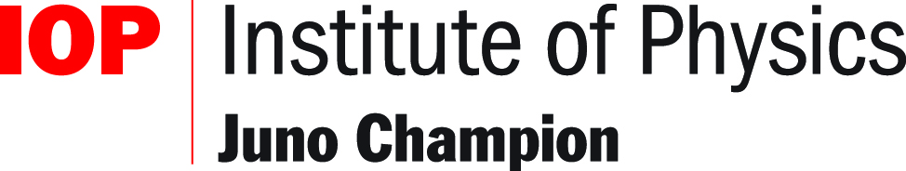
Gendered differences in response to assessment tasks: Myth and reality
Sally Jordan, School of Physical Sciences, The Open University @SallyJordan9
EAMS 2020

Slide 2
Acknowledgements
With grateful thanks to our funders:
The Ogden Trust
eSTEeM (The Open University’s STEM scholarship centre)
and to…
Dr Holly Hedgeland
Hillary Dawkins
Mark Parker

Slide 3
Demographic gaps in retention and attainment
Certain groups of students, e.g. those of particular gender, socio-economic group or ethnicity or with a disability, are considerably less likely to progress through qualifications and so to succeed in their study of physics.
So far, our efforts have concentrated on the gender gap; others, notably Gordon Hunter at Kingston, have looked at differences between BAME and white students. The intersections between different factors are important.
Note that these are trends; some women and BAME students do very well. I also acknowledge that gender is not a binary division.
We are looking for explanations for an effect that is clearly present, in an attempt to improve the student experience for all.

Slide 4
Our gender gap
Men have been significantly and consistently more likely to complete the Stage 2 “physics gateway” module S217 (and its predecessor S207) than women.
Of those who complete, men have also been more likely to pass.
The effect is not present in our level 1 modules, in maths modules, or in any other Science level 2 modules except for S282 (Astronomy), where women also do less well but the difference is not so stark.
Women do slightly better on our level 3 physical science modules and quite a lot better on the project module.

Slide 5
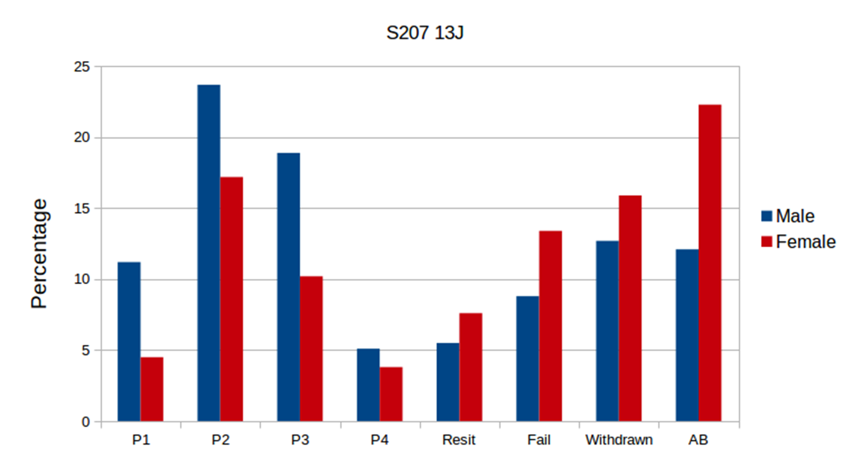
The gender gap on S207/ S217

Slide 6
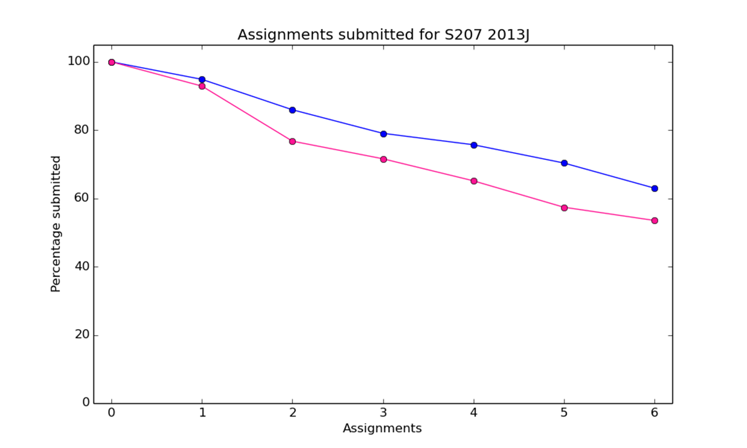
When do students stop studying?
When does the gap occur?

Slide 7
Initial hypotheses
There are other demographic differences (e.g. previous educational qualifications, where they live) between our male and female students.
There are other differences between our male and female students e.g. in the amount of time they have available for study.
Lack of female role models (Etzkowitz et al., 1994).
Lack of self confidence (Sharma & Bewes, 2011).
Something in our teaching and/or assessment is (on average) favouring men.
On average, women and men learn physical concepts and the skills of physics in a different way.

Slide 8
What might be causing differences in response to assessment?
Gendered context (McCullough, 2004)
Types of question; multiple choice questions are thought to disadvantage women (e.g. Everaert & Arthur, 2012; Hudson, 2010).
Something in the presentation of the question: the number of words, type of diagrams etc. (e.g. Wilson et al., 2016).
Length of test (Balart & Oosterveen, 2019)
The amount of scaffolding; Gibson et al. (2015) found that increasing the amount of scaffolding removed the gap between men and women’s grades, whilst improving both.
What the question assesses.

Slide 9
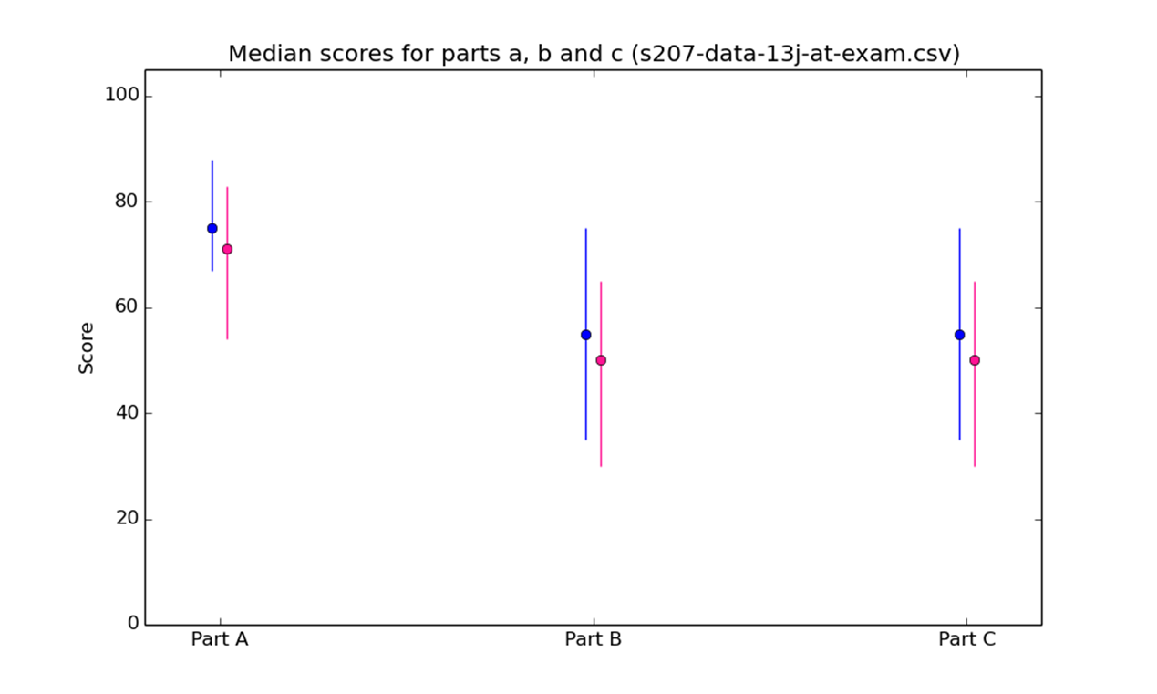
Performance on different parts of the S207 exam
Part A is multiple-choice questions; Part B is short answer questions; Part C is longer questions (with choice)

Slide 10
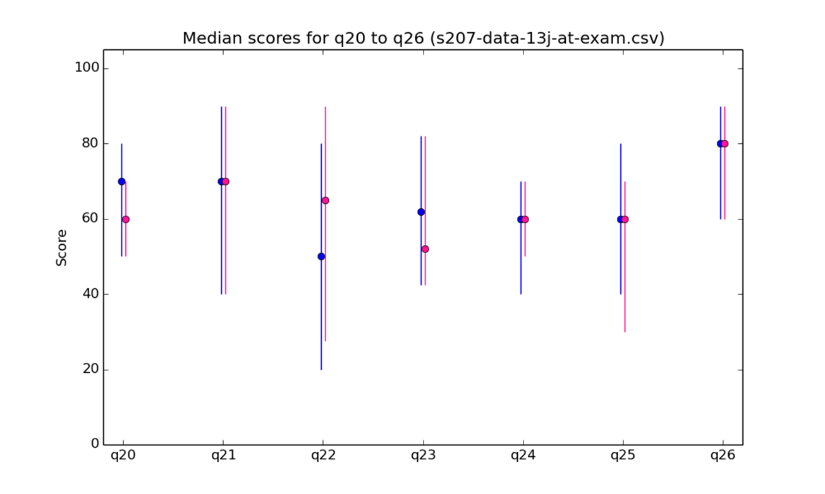
Performance on different Part C questions in the exam

Slide 11
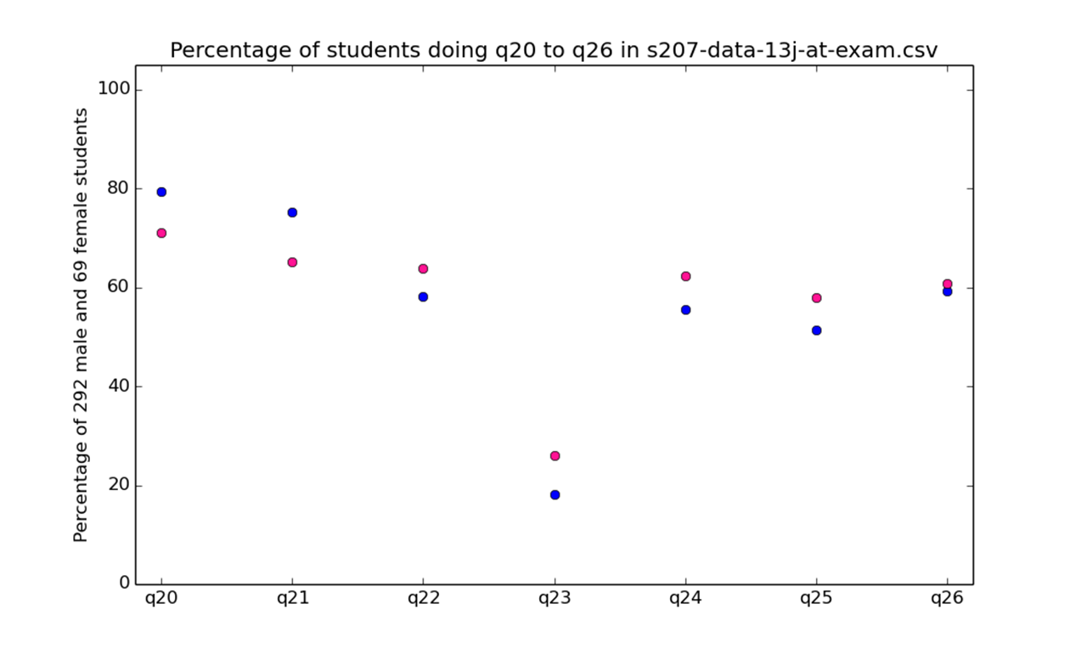
Choice of different Part C questions in the exam

Slide 12
Looking in more detail
We have investigated the effect of scaffolding, especially on problem-solving questions (see Dawkins et al., 2017)
We have also further investigated the hypothesis that multiple-choice questions disadvantage women, by looking at the multiple-choice sections of the exams for several modules and also by looking at interactive computer-marked assignments (iCMAs) for several modules.

Slide 13
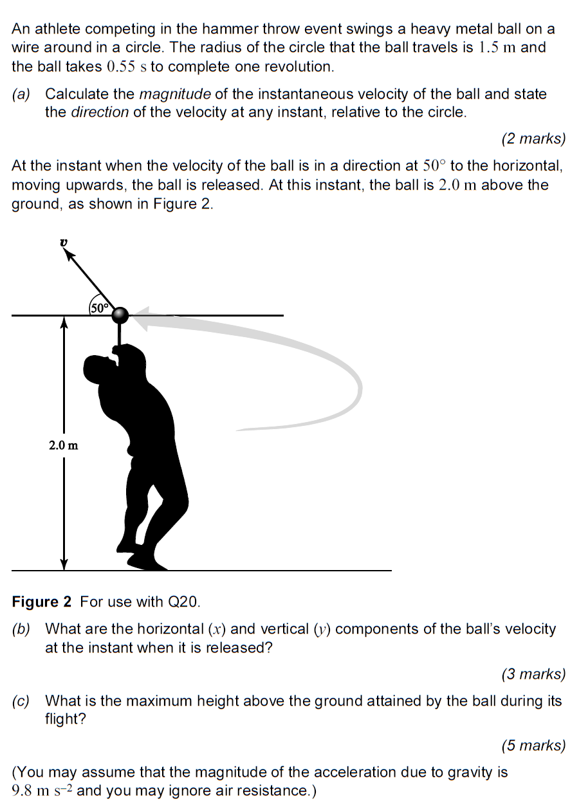
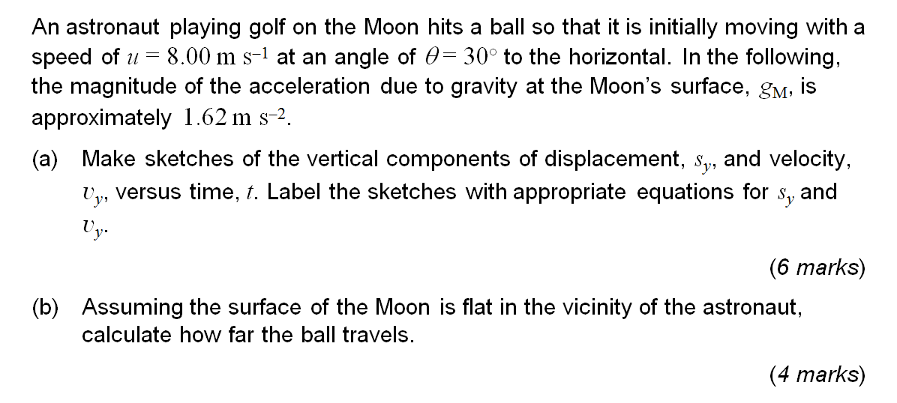
The effects of scaffolding
Scaffolding helps mid-scoring students the most
But perhaps can be used to reduce the effects of male bias

Slide 14
Taking this work forward
Scaffolding can be helpful for mid-range students.
However, extensive scaffolding alters what is being asked.
Most physicists think that the skill of solving an open-ended problem is an essential part of “being a physicist”.
So, perhaps the solution lies in helping students learn how to “self-scaffold”.
This work is being taken forward in an Ogden Trust-funded PhD studentship (Arran Stirton starts with us in October 2020).

Slide 15
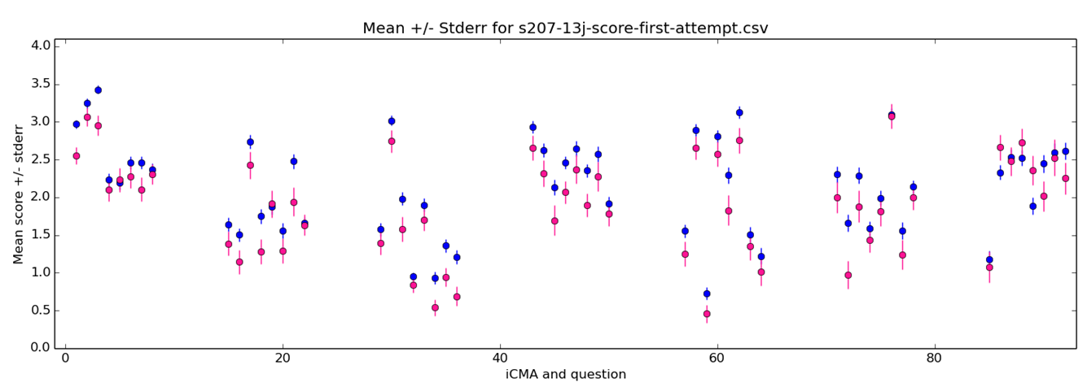
Looking at interactive computer-marked questions
Note:
we use a wide range of questions, from multiple-choice to automatically marked free-text short answer questions, and students can have multiple tries (with feedback provided between the tries)
At the time of this plot, the interactive computer-marked assignments were operating in a formative thresholded assessment strategy.

Slide 16
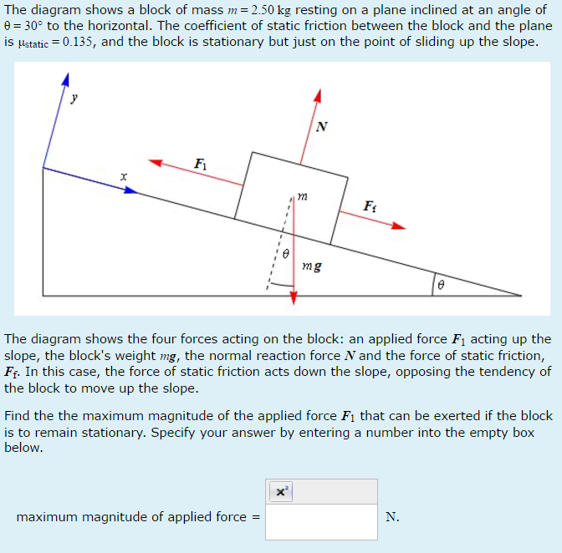
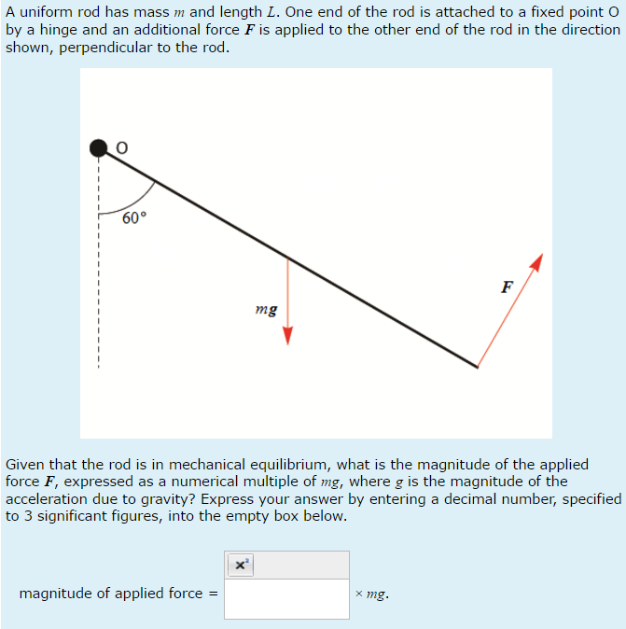
Measuring the gap
The size of the gap varies hugely from question to question and is often not statistically significant
Of 56 iCMA (computer marked) questions, 3 show significant male bias

Slide 17
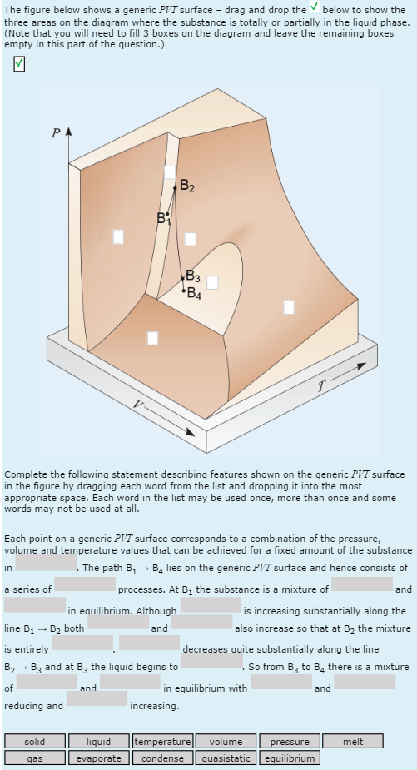
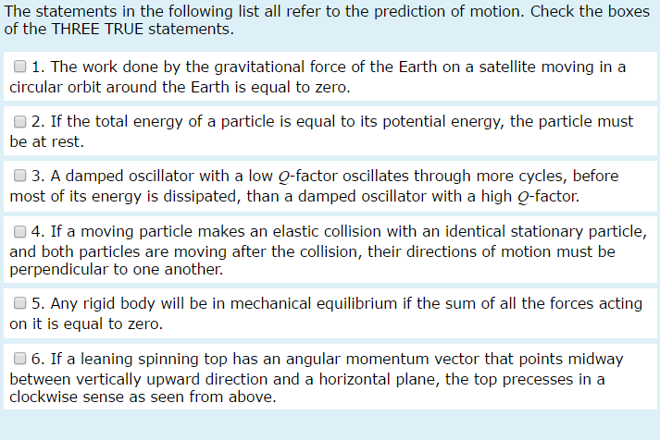
The effects of question type
All involve interpreting a multi-dimensional diagram
One is thermodynamics; the others mechanics
But some predicting motion questions show a (less significant) female bias

Slide 18
Looking at the Force Concept Inventory (FCI)
Test of conceptual understanding of Newtonian mechanics, widely used across the sector (Hestenes et al., 1992)
Conventionally relies on MCQs.
Conventionally men do better than women, particularly on some questions (Henderson et al., 2019)
Our PhD student Mark Parker has developed a free-text version of the FCI; the developmental version had roughly half free-text and half MCQs.
The gender gap persists…but the effect was larger and more significant for the MCQs.
But half of the MCQs were trajectory questions. Is this the explanation?

Slide 19
Looking at the Force Concept Inventory (FCI)
Test of conceptual understanding of Newtonian mechanics, widely used across the sector (Hestenes et al., 1992)
Conventionally relies on MCQs.
Conventionally men do better than women, particularly on some questions (Henderson et al., 2019)
Our PhD student Mark Parker has developed a free-text version of the FCI; the developmental version had roughly half free-text and half MCQs.
The gender gap persists…but the effect was larger and more significant for the MCQs.
But half of the MCQs were trajectory questions. Is this the explanation? It appears the answer is no!

Slide 20
PAUSE
Assessment may be having some effect…and we need to be careful to avoid bias in all ways that we can:
“By now it should be clear that there is no such thing as a fair test, nor could there be: the situation is too complex and the notion simplistic. However…we can begin to work towards tests that are more fair…” (Gipps & Murphy, 1994, pp 273-274)
However, the evidence is somewhat equivocal and the effects seem to be small.

Slide 21
PAUSE
Could the problem be partly WHAT we are assessing, e.g. is it right to start with Newtonian mechanics? Some evidence that some women might struggle with more abstract aspects and unrealistic “real world” examples e.g. “spherical cows” (Philander and Hastenrath, 2003)
What else might be going on?
Might there be hidden demographic differences between our male and female students?

Slide 22
Are we sure there aren’t any demographic differences?
There are no obvious differences between the distribution of other demographic factors (e.g. age, previous educational qualifications etc.) for men and women.
However, there is some indication that women with other characteristics, in particular
having less than two A levels (or Highers)
not having English as a first language
may be particularly likely to withdraw.
There is also some evidence that women appreciate different aspects of student support/tuition than men.
Although the proportion of students with A levels is similar for men and women, we don’t know how many have A levels in maths and physics.

Slide 23
PAUSE
Could the problem be partly WHAT we are assessing, e.g. is it right to start with Newtonian mechanics? Some evidence that some women might struggle with the more abstract aspects and the unrealistic “real world” examples e.g. “spherical cows” (Philander and Hastenrath, 2003)
What else might be going on?
Might there be hidden demographic differences between our male and female students?
We have undertaken a regression analysis to determine which of a number of factors best predict success on S217

Slide 24
Regression analysis into factors correlated with completion.
If you get to the end of this particular module you are likely to..(in order of descending significance)
be registered on our Maths & Physics Degree (Q77)
have not studied MU123
not be disabled
be white
be male
have A levels or higher
Age, socio-economic status, geographical location and amount of concurrent study do not seem significant.

Slide 25
But
What is cause and what is effect?
Some of the factors are proxies for other things (e.g. students who have studied MU123 are likely to have a weak mathematical background).
The variables may not all be truly independent e.g. a higher proportion of men studying S217 are registered on our Maths & Physics Degree than you might expect.

Slide 26
Student choice
S217 students registered on our Maths and Physics Degree have an increased probability of both:
Being male
Completing the module
So it appears that potential students in different demographic groups make different choices. (Also remember that men and women are likely to make different choices of exam questions)
Why?

Slide 27
References
Balart, P., & Oosterveen, M. (2019). Females show more sustained performance during test-taking than males. Nature communications, 10(1), 1-11.
Dawkins, H., Hedgeland, H. & Jordan, S. (2017). The impact of scaffolding and question stucture on the gender gap. Physical Review Physics Education Research, 13, 020117.
Etzkowitz, H., Kemelgor, C., Neuschatz, M., Uzzi, B., & Alonzo, J. (1994). The paradox of critical mass for women in science. Science, 266(5182), 51-54.
Everaert, P., & Arthur, N. (2012). Constructed-response versus multiple choice: the impact on performance in combination with gender. Issues in Accounting Education, 27(1), 55-82.
Gibson, V., Jardine-Wright, L., & Bateman, E. (2015). An investigation into the impact of question structure on the performance of first year physics undergraduate students at the University of Cambridge. European Journal of Physics, 36(4), 045014.
Hedgeland, H., Dawkins, H., & Jordan, S. (2018). Investigating male bias in multiple choice questions: contrasting formative and summative settings. European Journal of Physics, 39(5), 055704.

Slide 28
References cont.
Henderson, R., Stewert, J. & Traxler, A. (2019). Partitioning the gender gap in physics conceptual inventories: Force Concept Inventory, Force and Motion Conceptual Evaluation, and Conceptual Survey of Electricity and Magnetism, Physical Review Physics Education Research, 15, 010131
Hestenes, D., Wells, M., & Swackhamer, G. (1992). Force concept inventory. The Physics Teacher, 30(3), 141-158.
Hudson, R. D. (2010). Multiple-choice questions compared to short-answer response: which assesses understanding of chemistry more effectively? (Doctoral dissertation, Curtin University, Science and Mathematics Education Centre).
McCullough, L. (2004). Gender, context, and physics assessment. Journal of International Women's Studies, 5(4), 20-30.
Philander, S. G., & Hastenrath, S. (2003). Of dipoles and spherical cows. Bulletin of the American Meteorological Society, 84(10), 1424.
Sharma, M. D., & Bewes, J. (2011). Self-monitoring: Confidence, academic achievement and gender differences in physics. Journal of Learning Design, 4(3), 1-13.
Wilson, K., Low, D., Verdon, M., & Verdon, A. (2016). Differences in gender performance on competitive physics selection tests. Physical Review Physics Education Research, 12(2), 020111.

