Slide 1
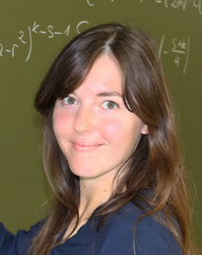
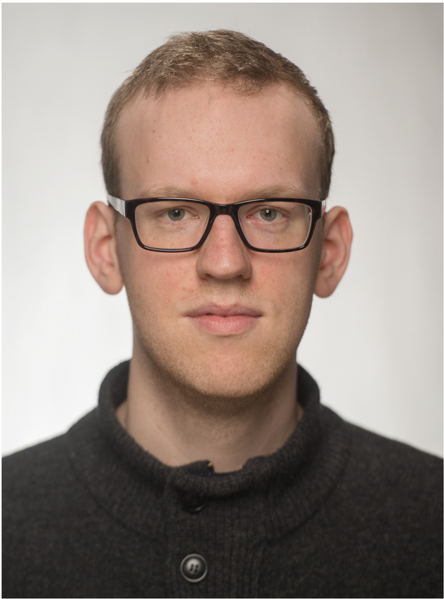

Studienstart.de – our web-based pre-course in mathematics for engineering students
Dr. Miriam Weigel, Johann Franke, David Obermayr | ZeMath DHBW Mannheim / optes project

Slide 2
Baden-Wuerttemberg Cooperative State University Mannheim
Dual system (practical and theory terms)
Courses in the Faculties of Business and Technology
Approximately 6,300 students enrolled in Mannheim
Over 2,000 companies are training partners in Mannheim
1st July 2020

Slide 3







Joint project, funded by the German Federal Ministry of Education and Research (BMBF) and its “Quality pact for teaching”.
Partner universities and institutions:

Slide 4
Study preparation in mathematics at DHBW Mannheim
Open for self-registration from June 1st
Participants: Students in a technical degree programme at DHBW Mannheim (Bachelor of Electrical Engineering, Mechanical Engineering, Mechatronics, Industrial Engineering, Computer Science)

Slide 5
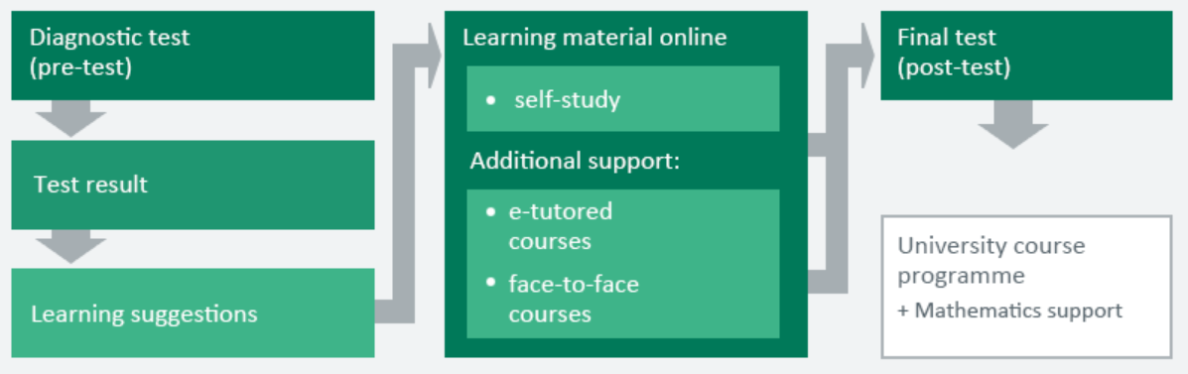
Course structure
Diagnostic test covering all subjects of the course
Learning material with learning modules, tests and trainings
Final test on all subjects

Slide 6
Our courses at DHBW Mannheim
Self-study: online courses available from June with self-assessment and forum; for free
E-tutored courses: online courses supervised by e-tutor; weekly exercises corrected by e-tutor; 4 weeks in September; for free
Face-to-face courses: paper-based courses; 1 - 2 weeks in September and November; participation fee

Slide 7







The curriculum
Summary of mathematical basics
0 Mathematical basics
Arithmetic
Equations and inequalities
Powers, roots, logarithms
Functions
Geometry
Trigonometry
Repetition of secondary school curriculum

Slide 8





Further courses
Linear Algebra
Limits and continuity
Calculus
Logic
Stochastics
Subject-specific content
New courses 2020

Slide 9
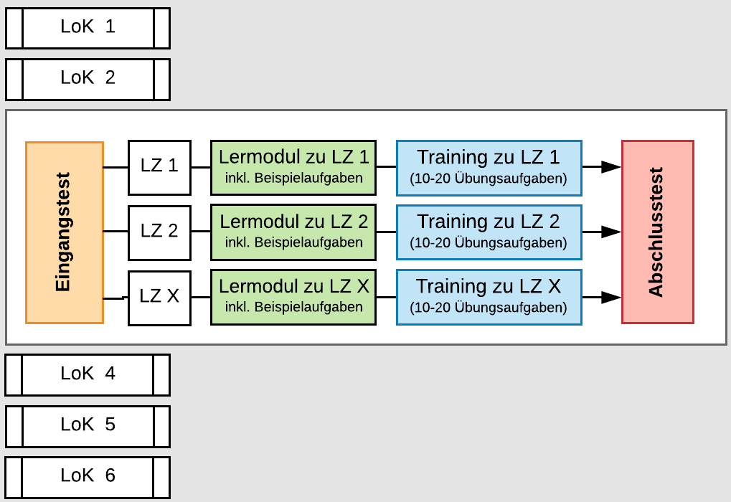
Structure of a course
Pre-test
Learning material:
  Theory
  Trainings
Post-test
Lernmodul zu LZ 1
inkl. Beispielaufgaben
Lernmodul zu LZ 2
inkl. Beispielaufgaben
Lernmodul zu LZ 3
inkl. Beispielaufgaben

Slide 10
Our concept
Didactical concepts by Bloom, Baumgarten, Mayer, the Conference of Ministers of Education (KMK 2012) and the Minimum requirements catalogue in mathematics by the cosh group („Mindestanforderungskatalog Mathematik, Version 2, 2014“)
Representation: precise and clear in electronic form with many animations, examples and exercises
Controlled learning paths using examples and exercises with detailed feedback on the solution (and submission of tasks)

Slide 11
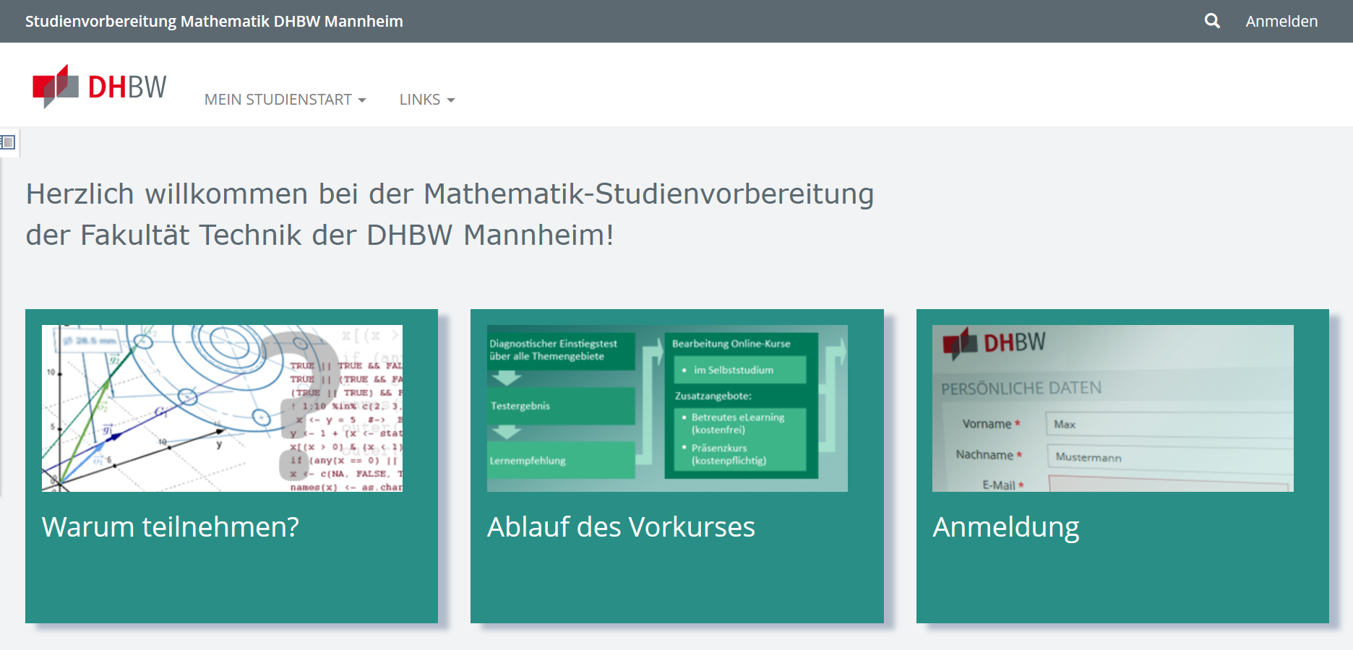
https://studienstart.dhbw-mannheim.de

Slide 12
Evaluation

Slide 13
Pre-course programme 2019
Database participants
First year students technical faculty* | 748
Pre-course participation yes / no | 582 (78%) / 166 (22%)
Evaluation survey | 126 (17%)
*Electrical Engineering, Mechanical Engineering, Mechatronics, Industrial Engineering, Computer Science
Database test items
Courses | 11
Learning modules / trainings | 35
Trainings with STACK items | 13
No. of standard ILIAS items (SC, MC, cloze) | 84
No. of STACK items | 36

Slide 14
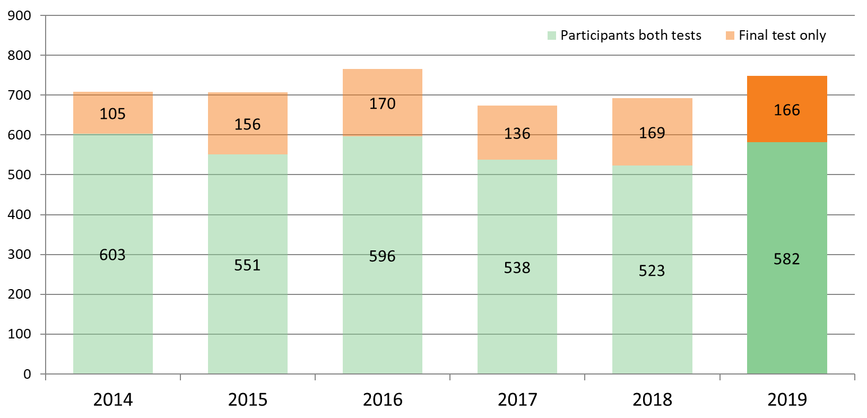
Pre-courses
Number of participants 2014 to 2019*
* Database: Enrolled students with at least 1 test

Slide 15
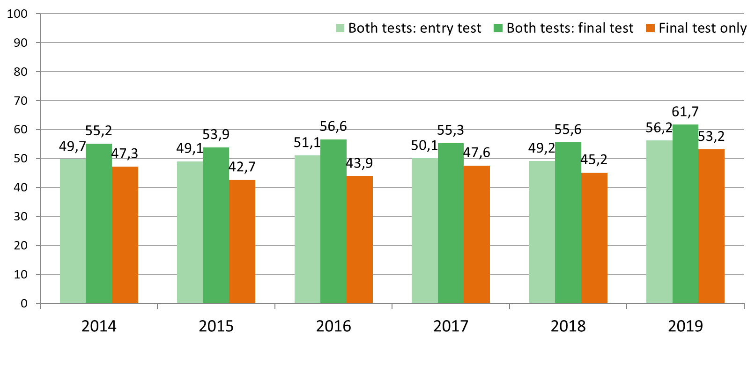
Diagnostic entry test and final test
Results in % (participants both tests | final test only)
n =
603 | 105
551 | 156
596 | 171
538 | 136
523 | 169
582 | 166
* Database: Enrolled students with at least 1 test

Slide 16
Gain Score per test attempts
"at risk" group versus no risk

Slide 17
Lessons learned
Students get along very well with the online material and like the online tests and trainings (combination of different question types, immediate detailed feedback).
They don‘t use the forum but prefer emails.
Students have problems managing their timetable.
Motivation decreases with time.
Gain score increases with test attempts.

Slide 18

Support was provided by the German Federal Ministry of Education and Research (BMBF) in the context of the Federal “Quality pact for teaching” (ref. number 01PL17012). Responsibility for the content rests exclusively with the authors.
More information on optes: www.optes.de; https://demo.optes.de
Pre-course DHBW Mannheim: https://studienstart.dhbw-mannheim.de
Contacts: Miriam Weigel miriam.weigel@dhbw-mannheim.de
Johann Franke johann.franke@dhbw-mannheim.de
David Obermayr david.obermayr@dhbw-mannheim.de
?
!
!
?
Questions/discussion
All optes e-learning contents are CC-licensed.
All optes software developments are GPL-licensed.

