Slide 1
E-assessment at masters level: a case study from the Open University's MSc in Mathematics using STACK
Ben Mestel
School of Mathematics & Statistics
The Open University, UK
Joint work with Grahame Erskine & Tim Lowe
EAMS 2021
2 July 2021

Slide 2
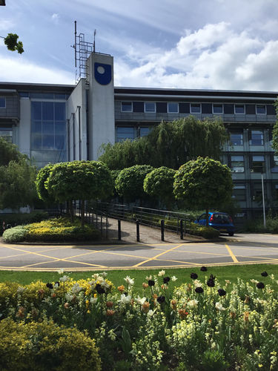
The Open University (OU)
Britain’s distance learning university since 1969
Based in Milton Keynes but with offices around the UK in England, Northern Ireland, Scotland and Wales
168,000 students, most studying part-time
Levels from opening to BSc to Masters and PhD
Modus Operandi: high quality course notes, supplemented by tutor-marked assignments, correspondence tuition and face-to-face/online tutorials
Berrill Building, Walton Hall Campus,
Milton Keynes

Slide 3
e-Assessment at the OU
The OU was a pioneer in computer-marked objective testing (i.e. multiple choice)
Developed its own bespoke e-assessment system – OpenMark (excellent system but required professional programming in many instances)
Since 2008 significant investment in the STACK system although and other systems used as well
Early e-assessment at the
OU pioneered by Phil Butcher

Slide 4
STACK AT THE OU
Integrated as part of the Moodle Quiz Engine in the Virtual Learning Environment
1.3 million STACK questions annually
Tim Lowe and Tim Hunt
Chris Sangwin

Slide 5
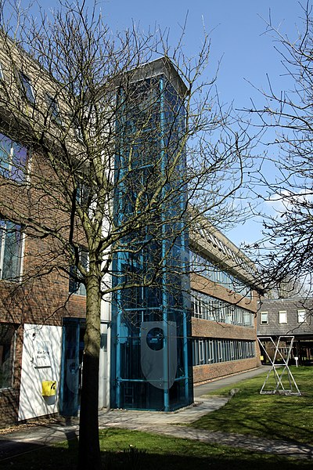
Mathematics Master of Science
Mathematics MSc offered since 1980s
About 500 students
2 - 6 years to complete 6 30-credit modules
Modules cover a range of subjects in pure and applied mathematics but not statistics
STACK used for two modules:
M820 Calculus of Variations and Advanced Calculus
M823 Analytic Number Theory I
Modules mainly assessed by final exam
Alan Turing Building at Open University
Campus in Milton Keynes, Spring 2013
Photo by: Chmee2

Slide 6
M820 Calculus of Variations & Advanced Calculus
Introductory module of the MSc programme
About 130 students annually
8 multi-question STACK quizzes were developed to assist with learning and preparation for the module exam (currently taken remotely)
30 STACK questions in total
STACK questions developed first in 2017 and extended in 2020

Slide 7
8 multi-question STACK quizzes
Solution of the Euler-Lagrange differential equation for quadratic functionals to obtain the stationary path.
Solution of variational problems through the first-integral, for those functionals permitting such an approach.
Local classification of stationary paths of functionals into minima, maxima and saddle points, through the analysis of the Jacobi differential equation.
Calculation of the Noether invariants (first-integrals) for functionals invariant under a scale change in the variables.
Diagonalisation of quadratic functionals involving two dependent variables, therefore allowing the stationary paths to be calculated by the solution of two independent variational problems.
Constrained variational problems with integral constraints.
Non-fixed endpoint conditions using the transversality condition.
The use of the Rayleigh-Ritz method to find an upper bound for the least eigenvalue of a Sturm-Liouville problem.

Slide 8
Crash course in Calculus of Variations
Applications in physics, biology, control engineering, economics and chemistry and more...
Extremal paths of functionals of the form
$\int_{a}^{b}{dx F(x,y,y^{′})}$
(and generalisations) together with boundary conditions and constraints.
Stationary paths solve Euler-Lagrange equation $\frac{d}{dx}\left(\frac{∂F}{∂y^{′}}\right)− \frac{∂F}{∂y}=0$
Second order differential equation – boundary value problem

Slide 9
Classification via Jacobi equation
Classification of stationary paths into local maxima, local minima and saddles – generally a hard problem ☹
One approach – solve the Jacobi differential equation initial value problem
$\frac{d}{dx}\left( P\frac{du}{dx} \right)–Q u=0, u\left(a\right)= 0, { u}^{′}\left(a\right)= 1,$where
$P=\frac{∂^{2}F}{∂y^{′2}},$ and $Q=\frac{∂^{2}F}{∂y^{2}}−\frac{d}{dx}\left(\frac{∂^{2}F}{∂y∂y^{′}}\right),$evaluated on the stationary path $y\left(x\right).$
If $u\left(x\right)$ has no zeros (“conjugate points” in the jargon) in the half-open interval $(a,b]$ then $y(x)$ is a local minimum if $P>0$ on $[a,b]$; a local maximum if $P< 0$ on $[a,b]$; and a saddle if $P$ changes sign on $\left[a,b\right]$. Further analysis is needed in other cases.

Slide 10
Devising a question
Restrict to quadratic functionals of the form
$$\int_{a}^{b}{dx (α_{0} x^{m}{y^{′}}^{2}+β_{0}}x^{m−2}y^{2}) ,$$
on $\left[a,b\right],$with boundary conditions $y\left(a\right)=A$, $y\left(b\right)=B$, where$A$, $B$are constants, chosen to reduce the algebra
The constants $a,b$ and $α_{0}$, $β_{0}$ and $m$ specialised as below.
For this example the Euler-Lagrange equation and the Jacobi equation are the same equation (but different problems !)

Slide 11
Solving Jacobi
Jacobi equation is Euler equation
$$A_{2}x^{2}\frac{d^{2}u}{dx^{2}}+A_{1}x\frac{du}{dx} +A_{0}u=0,$$
$$u\left(a\right)=0, u′\left(a\right)=1,$$
where $A_{2}= α_{0},$ $A_{1}=mα_{0}$, and $A_{0}= −β_{0}$. The usual transformation $x=e^{t}$ leads to
$$A_{2}\frac{d^{2}u}{dt^{2}}+{(A}_{1}−A_{2})\frac{du}{dt} +A_{0}u=0,$$
$$u\left(\log{a}\right)=0, u′\left(\log{a}\right)=1.$$
Choose auxiliary $λ^{2}−2ρλ+ ρ^{2}+ω^{2}=0$, where $ρ$ and $ω$ are ‘nice’ constants with $ω≥0$ and $ρ,ω$ not both zero.
$u\left(x\right)={\left(\frac{a}{ω}\right)\left(\frac{x}{a}\right)}^{ρ}\sin{(ω\log{(x/a}}))$for $ω>0$ and
$u\left(x\right)=a {\left(\frac{x}{a}\right)}^{ρ}\log{(x/a})$ for $ω=0$.

Slide 12
Restricting and randomizing
To reduce complexity, restrict to $a=1$ and $ω>0$, so $u\left(x\right)={\frac{1}{ω}x}^{ρ}\sin{(ω\log{ x}})$
Zeros of $u\left(x\right)$ in $(1,b]$ if and only if $ω\log{ b }≥π$
Vary choice of $ω$ and $b$to flip between the two cases
no zeros & Jacobi test applies
at lest one zero & Jacobi test fails.
In the first case,
minimum if $P\left(x\right)=2α_{0}>0$
maximum if $P\left(x\right)=2α_{0}<0$.
($P$ is of fixed sign (for $α_{0}≠0$) so the stationary path is either a local maximum or a local minimum.)

Slide 13
Euler-Lagrange equation
Euler-Lagrange boundary value problem:
$$A_{2}x^{2}\frac{d^{2}y}{dx^{2}}+A_{1}x\frac{dy}{dx} +A_{0}y=0,$$
$$y\left(a\right)=A, y\left(b\right)=B$$
For simplicity choose $A=0$ and $B=kb^{ρ}\sin{ω\log{b}},$where $k$ is a small random positive integer
Stationary path $y\left(x\right)=k x^{ρ}\sin{(ω\log{x)}}$

Slide 14
STACK Jacobi Quiz

Slide 15
Question in practice: feedback

Slide 16
How did it STACK up?
Well received by students
“Started using these for exam revision. Great questions and the answers are very well written. Would love to see more types of questions.”
“Practice quizzes were fabulous for revision”
“In particular the practice quizzes and screencasts were by far the most helpful!”
Modern Book Printing, Walk of Ideas,
Berlin, 2006. Photo: Matthew6476 CCSAL

Slide 17
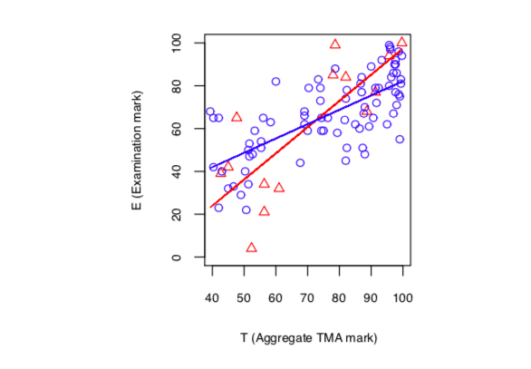
Statistical analysis of first-year
Blue: interacted with quizzes
E = 15.20 + 0.67T
Red: did not interact with quizzes
E = −24.99 + 1.22T
Exam mark vs
continuous assessment mark
From (Mestel & Lowe, 2019)

Slide 18
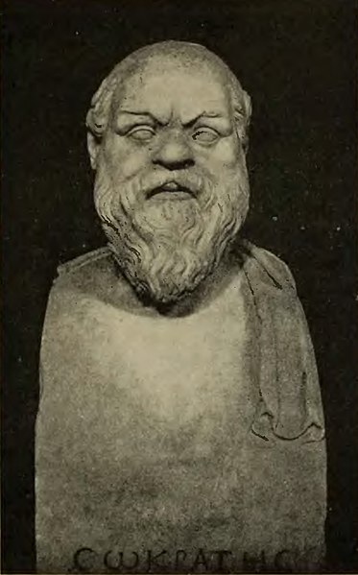
Some (STACK) authoring tips
Mostly common sense, but hopefully useful
Not hard and fast rules, rather suggestions
Based on our experience of authoring e-assessment questions in STACK and other systems
Feel free to disagree !
Bust of Socrates. Photo: Bregi

Slide 19
Some question authoring tips
Design and implementation: iterative process, useful to have more than one person involved
Start from the solution and derive the question
Check the answers - don’t pattern match
Handle each case separately – don’t try to do everything in one go
Helpful to solve the problem in CAS (Maxima) first, before implementation.
Randomise in Maxima and then select a good set of parameter values
Use multi-question quizzes not questions with many parts
Hard work to coax Maxima to display formulae nicely
Feedback is often the most time-consuming part and it is frequently omitted

Slide 20
2nd order inhomogeneous linear ODE with constant coefficients
$a_{2}\frac{d^{2}y}{dx^{2}}+a_{1}\frac{dy}{dx}+a_{0} y=f\left(x\right)= \left\{\begin{aligned}b_{0}+b_{1}x+…+b_{k}x^{k} \\ b_{0}\cos{μx}+b_{1}\sin{μx} \\ b_{0} e^{μx}\end{aligned}\right.$
$y\left(x_{0}\right)=y_{0}, y^{′}\left(x_{0}\right)=z_{0}$
Discriminant $Δ=a_{1}^{2}−4a_{2}a_{0} \left\{\begin{aligned}>0 \\ <0 \\ =0\end{aligned}\right.$, eigenvalue $\left\{\begin{aligned}λ_{1} , λ_{2} \\ λ±iω \\ λ, λ\end{aligned}\right.$
$y=y_{c}+y_{p}$, $y_{c}=C_{1} e^{λ_{1}x}+C_{2}e^{λ_{2}x}$ (for $Δ>0)$
$y_{p}=c_{0} e^{μx}$ ($μ≠λ_{1}, λ_{2})$

Slide 21
Thank you !
Grahame Erskine and Ben Mestel, Developing STACK practice questions for the Mathematics Masters Programme at the OU, MSOR Connections, 17 (1) (2018), http://dx.doi.org/10.21100/msor.v17i1.896
Ben Mestel and Tim Lowe, Using STACK to support student learning at masters level: a case study, Teaching Mathematics and its Applications, 03 (2019), https://dx.doi.org/10.1093/teamat/hrz001

