Slide 1
Maths assessment for financial literacy programmes in newly industrialised countries: The power of a graph database Pete Jarrett, Tutorum Technologies Ltd
Notes:
This short recording introduces a project focusing on financial literacy that has presented interesting challenges around pedagogy on digital platforms, and in this case, the pre-assessment of contextual functional numeracy skills. In particular, these challenges have highlighted how technology can manage some of the fundamental difficulties presented in traditional pedagogical approaches, and more importantly, how we can now begin to think of more efficient ways to provide adaptive and intelligent learning opportunities to a diverse set of learners through the prism of mathematics and computer sciences.

Slide 2
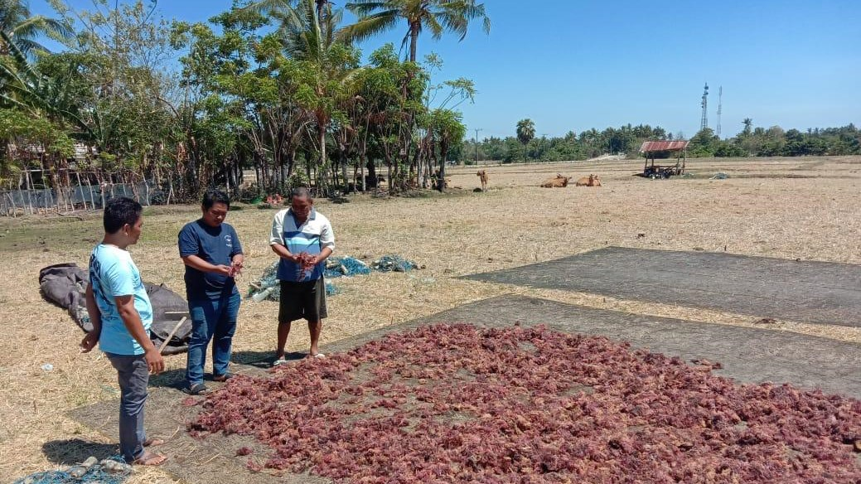
A case study
Many people in rural areas un-banked or partially banked and under-insured. High smartphone usage. Rollout of 4g and 5g is comprehensive.
Aim: To provide financial literacy education to a dispersed population to allow people to make better informed decisions about business development
Notes:
Tutorum have been involved in learning platform and digital curriculum design for a number of years now. Because of our early and mid career roles in Ecology, specific learning difficulties, particularly dyscalculia, and complex systems design we have always had an interest in the interface between pedagogy and data – especially, data to inform and guide learning rather than as evidence of learning.
We have recently been presented with a challenge that has given us the opportunity to think more deeply about many of the inefficiencies in traditional learning, both digital and face to face. We are in the early stages of a project with an NGO in Indonesia. Their client base ranges from employees of factories to rural cooperative involved in industries such as seaweed farming. The purpose of their activity is to build financial and disaster resilience and to allow for more sustainable supply chains that benefit the producer. There are a number of challenges in working across an archipelago and with a rural population

Slide 3
Learner challenges:
Wide variance in pre-requisite knowledge
Wide variance in access to formal learning opportunities
Different endpoints
Solution
Adaptive initial assessment and curriculum
Super-curriculum that connects pre-requisite contextualised maths knowledge and skills to the main course of learning
Notes:
We have always been guided by Bloom’s 2 sigma problem, and the benefit of moving away from ‘one and done’ courses. A focus of ours is the different start points that individual’s bring. Many courses around financial literacy make an assumption that people have the requisite skills to address the mathematics in the course. In reality this is unlikely within any group of learners. The levels of innumeracy in the UK are well recognised, with somewhere is the region of 25-30% of the working age population having difficulties with maths. The figures of 5-7% of the population with dyscalculia and 15% of the population with wider maths learning difficulties (such as impairments in working memory and speed of processing) further evidence the likelihood of a significant number of people struggling to access even foundational processes.
This also does not address a range of other barriers to successful engagement with learning, maths and other situational anxieties, differences in exposure to formal learning and the level of metacognitive learning abilities, digital literacy and first language literacy.
A sound initial assessment is part of the solution – however, finding out what someone doesn’t know can be time-consuming, and again influenced by the fuzziness of learning. Having established a position within a knowledge space, it is then possible to create an adaptive learning pathway through a set of points within a curriculum. Furthermore, it makes sense to build a curriculum that links elements from more than one domain of knowledge and skills. For example, in the case of financial literacy, to link back to numeracy and digital literacy, and forward to business literacy. Adaptive assessments and curriculum pathways are becoming increasingly available. However, because of some of the inherent complexities in these systems, they are often focused at educational settings where license costs per user reflect the costs inherent in building complex systems.

Slide 4
Technical challenges:
Mobile first, data light, 3/4g – balancing high latency and poor bandwidth but offering a compelling UX
Client base requires low user cost and high completion rate - ROI
Solution
Off the shelf solutions rather than built from the ground up
Learning is a fuzzy process – graph databases manage fuzzy better that relational databases
Notes:
Our challenge was to take our knowledge of adaptive learning and focus it towards some of the logistical and technical difficulties faced in working in a large archipelago.
Indonesia, like many parts of the World, is focusing much of it’s infrastructure roll-out on 3-5g. Reach is currently reasonable in many coastal areas, and the network is growing. Smartphone use is reasonably common, although in rural and less affluent areas there is much device sharing, and we are often working with older devices and legacy versions of os. Android is by far the most commonly used OS.
We have designed the platform to be mobile first and as data light as possible – for example, we use podcasts in preference to videos. In addition, we have been constrained by the need to keep user costs down to a reasonable and affordable cost, even though the likely business model is that costs will be born by financial institutions. We must also offer return on investment in time for the user, and therefore build a platform that encourages successful learning outcomes.
In short, we have looked for a cost effective solution to adaptive learning, that accommodates the complexities of the learning process – kind of taking Formula 1 technology and putting it in an affordable family car.

Slide 5
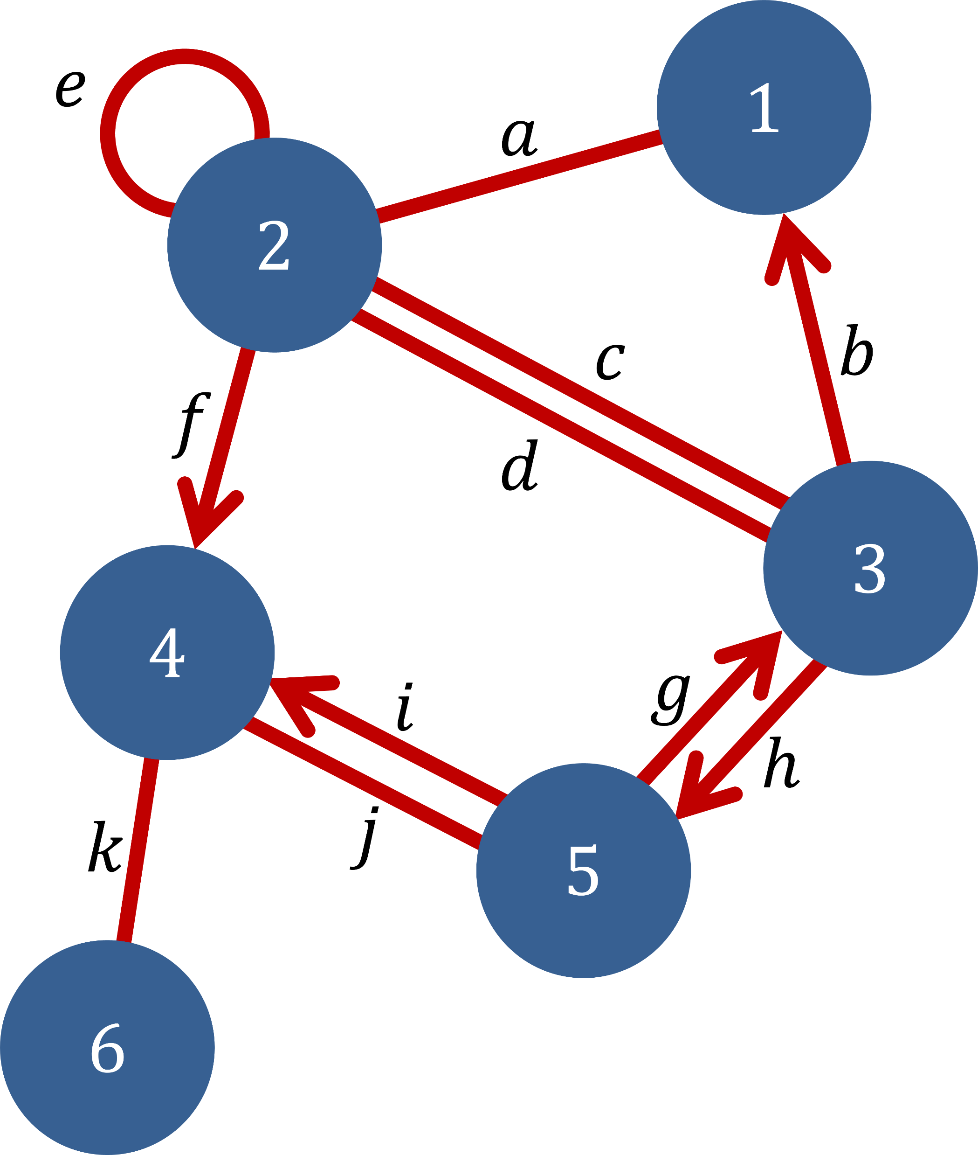
The graph database
Parts of a curriculum are seen as a node.
The relationships between nodes for learners are manages by weighted edges.
Adaptivity becomes a graph traversal problem.
Notes:
https://www.arangodb.com/resources/white-paper/multi-model-database/

Slide 6
The graph database
We have chosen ArangoDB as nodes and edges are managed as JSON documents.
This makes life a bit easier for developers as the dialogue with the CMS is straightforward.
The initial assessment is then managed as Markov Chain Monte Carlo.

Slide 7
The graph database – advantages
Quick and economical run-up
Straightforward link between front-end, database and then into ML tools – ArangoDB and Tensorflow
Global rollout
Playing with fuzzy logic, Bayes and Graph Theory

Slide 8
The graph database – disadvantages
Off the shelf but we can find no use cases in learning delivery – feels a bit lonely
Off the shelf so had to spend some time refocusing typical Customer/Logistics use cases

Slide 9
Maths assessment for financial literacy programmes in newly industrialised countries: The power of a graph database Pete Jarrett, Tutorum Technologies Ltd pete@tutorum.co.uk
Notes:
This short recording introduces a project focusing on financial literacy that has presented interesting challenges around pedagogy on digital platforms, and in this case, the pre-assessment of contextual functional numeracy skills. In particular, these challenges have highlighted how technology can manage some of the fundamental difficulties presented in traditional pedagogical approaches, and more importantly, how we can now begin to think of more efficient ways to provide adaptive and intelligent learning opportunities to a diverse set of learners through the prism of mathematics and computer sciences.

