Slide 1
Moodle quizzes with immediate feedback and unlimited attempts
28 June 2021
Mark MacDonald
Notes:
Main presentation title slide.

Slide 2
Student feedback
"I think that the format of the quiz was nice since, because I found that repeating it to get a better grade actually made me study the questions and better understand the material in a more interactive way (I could see that I was actually improving.)"
"Quiz style was great as it allowed you to learn from your mistakes."
"Also the explanations at the end of a quiz question after completion were very helpful in letting me know where I was going wrong and filling in gaps in knowledge."
"The quiz feedback is useful in identifying weaknesses in understanding, and it is nice to be able to try them again for revision purposes and to solidify understanding."
"The Moodle quizzes were very well thought of. The questions are formative and the feedback is very insightful. I appreciate that they take a long time to make, but this is definitely something other modules should copy."
"The quizzes are very formative and force you to look back at the notes and get a deeper understanding of the material."
"I feel I learn a lot from the quiz structure, where we have an attempt and then receive feedback and can then have another go. It allows me to learn from my mistakes and see how many I can get right the next time.
"I think the possibility to attempt quiz multiple times really helped me learn. Every time after I have finished it, I felt like I knew what I should work on to get to 100%. When I would finally get to the 100% I felt like I had a lot better understanding of the
material.

Slide 3
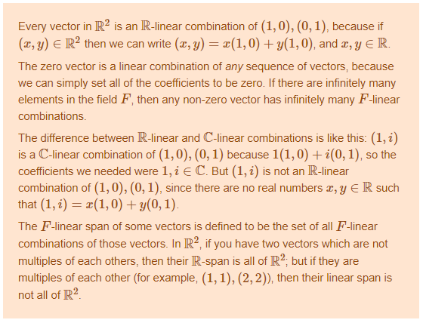
“Multiple True/False (MTF)” questions

Slide 4
Multi-attempt quiz design
Each weekly quiz counted as 1% of overall mark
Unlimited attempts (no penalty, last attempt counts)
Each question has 3-6 randomly chosen variants
> 1 week to complete
10 min. delay between submissions
Upon submission they get:
  General feedback
  Marks out of 4

Slide 5
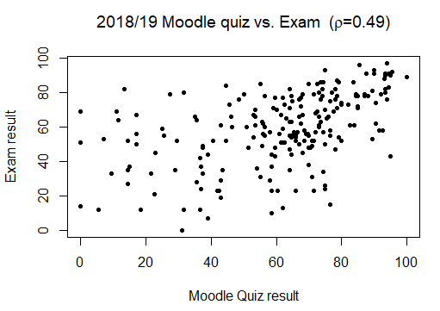
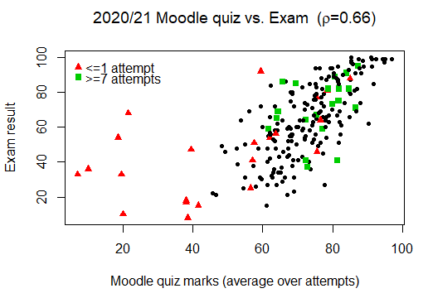
Results

Slide 6
Thoughts for the future
Convert R/Exams -> STACK (easier for me to make changes)
Last attempt -> Highest mark (encourage persistence)
  + limit attempts (discourage brute force)
Negative marking of incorrect answers (deflate grades)
2-hour time limit per attempt (encourage focus)
Ghabraie, Kazem. "Computer-marked assessments to enhance learning in engineering education." International Journal on Innovations in Online Education 4, no. 1 (2020).

Slide 7
Thanks!

