Slide 1
Optimising Maths Courses with Möbius

Slide 2
About DigitalEd...
300+ schools
440,000+ class enrollments
>17,000,000
automatically graded assessments
Notes:
Explain who we are - don’t say we came from Maplesoft.
DigitalEd is awesome in its own right, don’t make the story about another corporation
Headquartered in Waterloo, Canada with an office in the United Kingdom and partners all over Latin America, Europe and Asia.
DigitalEd has a worldwide presence.
North America, Latin America, Europe, Asia, Australia
440,000+ class enrollments -> total classes enrolled by all students (includes students enrolled in multiple classes)
Over 17 million submitted assessments since the inception of Mobius

Slide 3
Möbius brings complex STEM disciplines to life with its world-class math-engine.
Create and use powerful multimedia visualizations to anchor key STEM concepts.
Give students immediate and meaningful feedback and provide instructors with data on student engagement and understanding.
Go beyond simple question types with automatically marked, algorithmically generated randomized questions.
Access to high-quality content created by curriculum experts to let you get up and running quickly.
Seamlessly integrate Möbius with your Learning Management System (LMS).

Slide 4
Platform Bundled with Content
Fully immersive, digital courseware with dynamic content and instant feedback, yields impressive, measurable improvements in student learning outcomes.
Content Starter Packs for core STEM topics are included with the platform and can be customized by the customer
DEVELOPMENTAL MATH & PROBLEM SOLVING
PRECALCULUS & CALCULUS
CALCULUS I & II FOR SCIENCE
DIFFERENTIAL EQUATIONS
LINEAR ALGEBRA
COLLEGE ALGEBRA
COLLEGE PHYSICS
MECHANICS, WAVES & ACOUSTICS
PROBABILITY & STATISTICS
FINANCIAL MATH
HIGH SCHOOL MATH
ETC.
DigitalEd Content Starter Packs quickly demonstrate the power of the Möbius platform, and shortens both our sales cycle and speed of adoption to all STEM departments, increasing our total market share / revenue.
Notes:
Möbius Introductory Content Bundle
Grade 7 Math
Grade 8 Math
Grade 9 Math
Grade 10 Math
Grade 11 Math
Grade 12 Pre-Calculus
Grade 12 Calculus
Problem Solving
Euclidean Geometry
Calculus I for Science
Calculus II for Science
Introduction to Differential Equations
Problem Bank: Calculus
Problem Bank: Linear Algebra
Problem Bank: Probability
Problem Bank: Statistics

Slide 5
Math Question Types
General Math Functionality
> 50 Math Question Types
Math Expressions & Formulas
Math Equations, Systems of Equations
Math Applications (Interactive)
Math Graded, Open / Free-form Response
Numeric, Units, Tolerances
Trigonometry, Logarithms, Exponentials
Differential Equations: Solutions + Unevaluated
Integrals: Definite / Indefinite + Unevaluated
Matrix and Vector Operations
Sets and Lists
Plotting and Sketching
Free Body Diagrams
Chemical Equations
Adaptive Questions
HTML 5
General Functionality in all question types (hints, randomization, feedback, etc.)
Mathematical Equivalence
Open Response Questions
Equation Editor & Typeset Math
Randomization, Constraints
All Mathematical Constructs
Sets, Sequences, Series, Vectors, Matrices, Vector Fields, Tensors, Statistical Distributions, etc.
Interactive 2D/3D Visualization and Plots

Slide 6
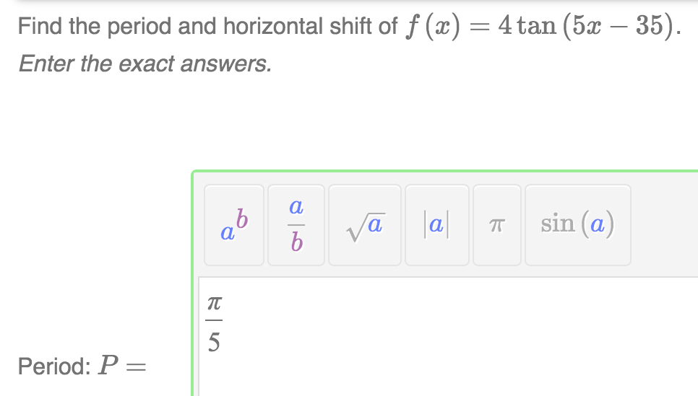
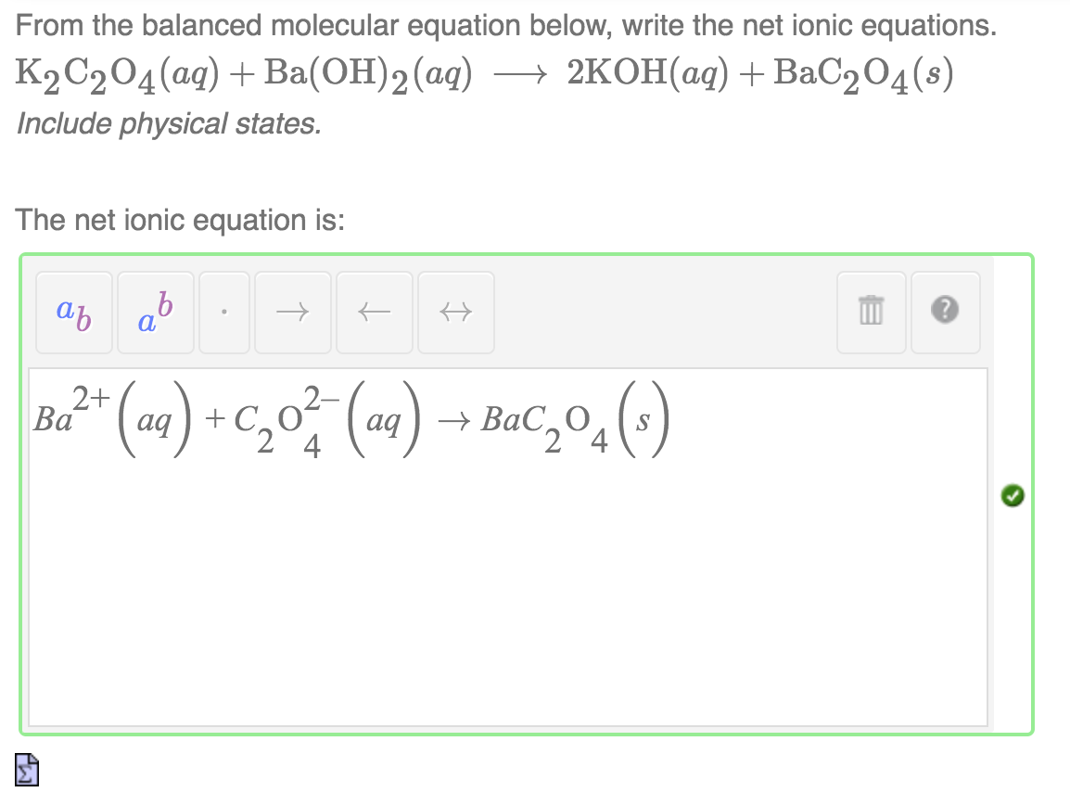
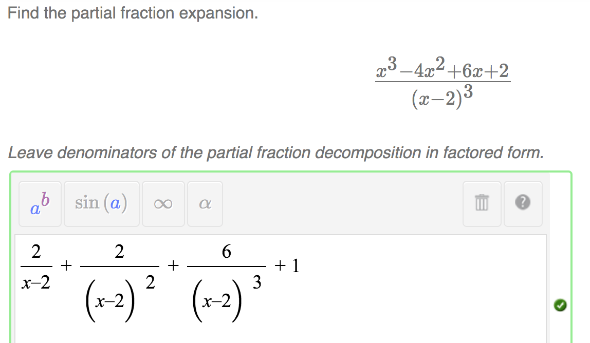
Math Expressions
& Formulas
Back
Notes:
‘Mathematical Formula’ and “Maple Graded’ questions grade input in several forms of formulas, including chemical formulas.
Math formulas are created using MathML and rendered using MathJax, which means screen readers can read them.
For more capabilities of equation editor palettes, see slide 20.

Slide 7
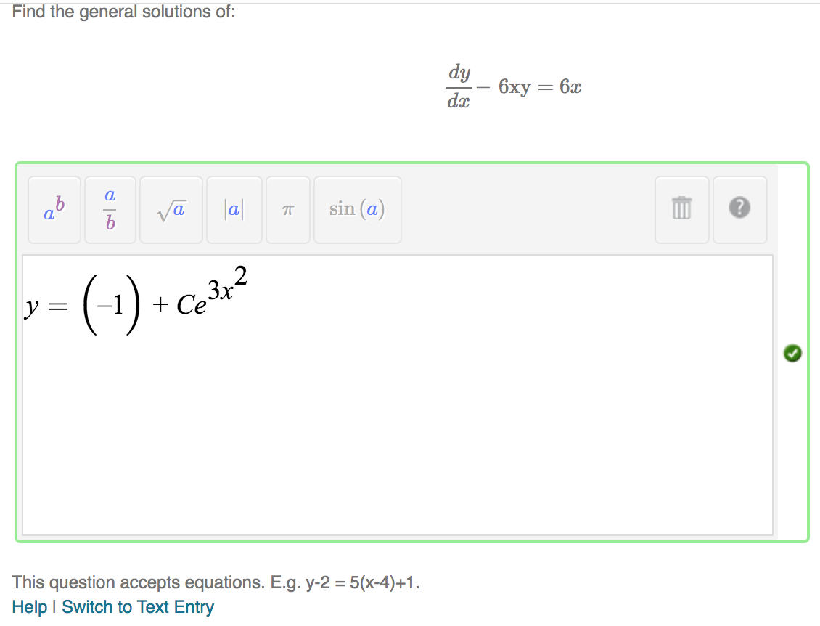
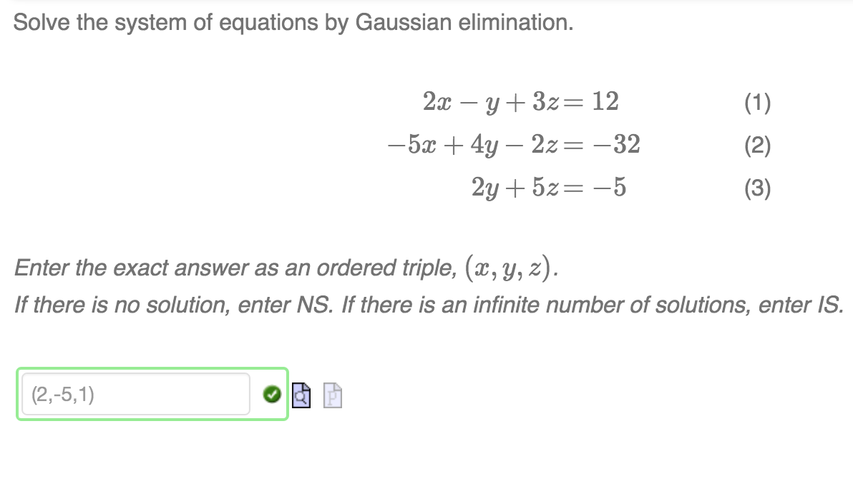
Math Equations and Systems of Equations
Back
Notes:
Möbius can handle all types of math expressions and equations, including systems of equations.
Systems of equations can be displayed as equations or as matrices.

Slide 8
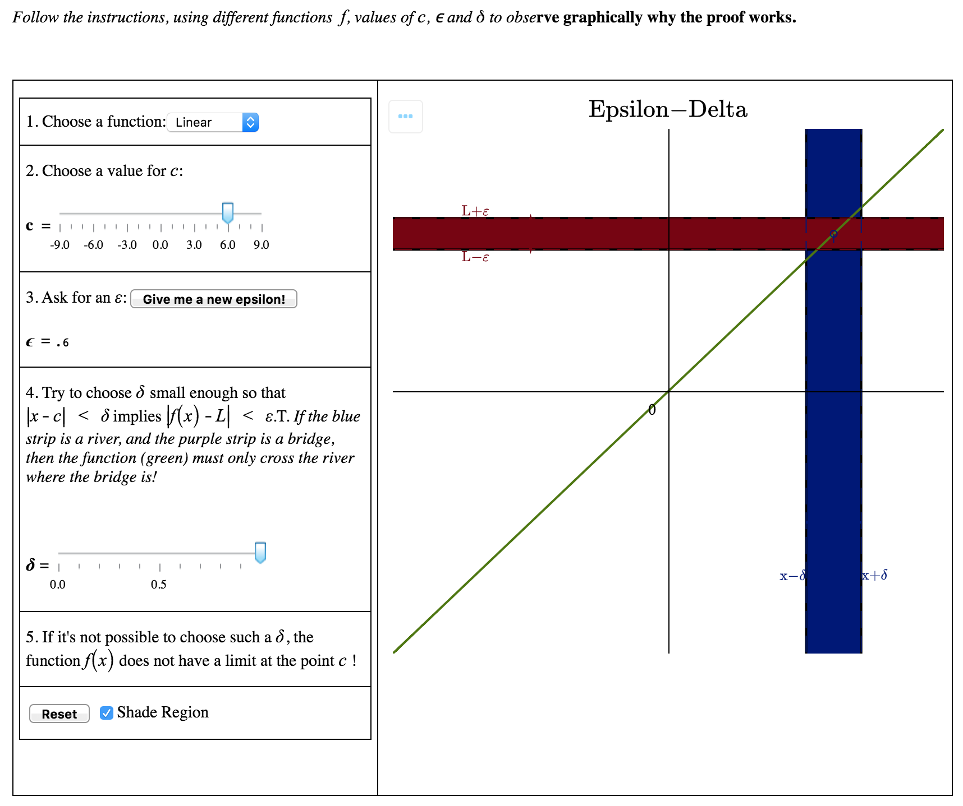
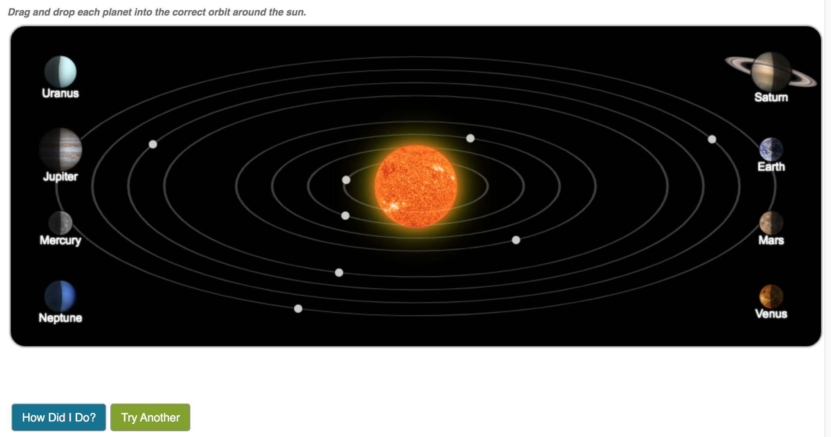
Math App and Interactive Questions
Back
Notes:
HTML and Math App question types let end users build their own response areas that meet their very specific needs.

Slide 9
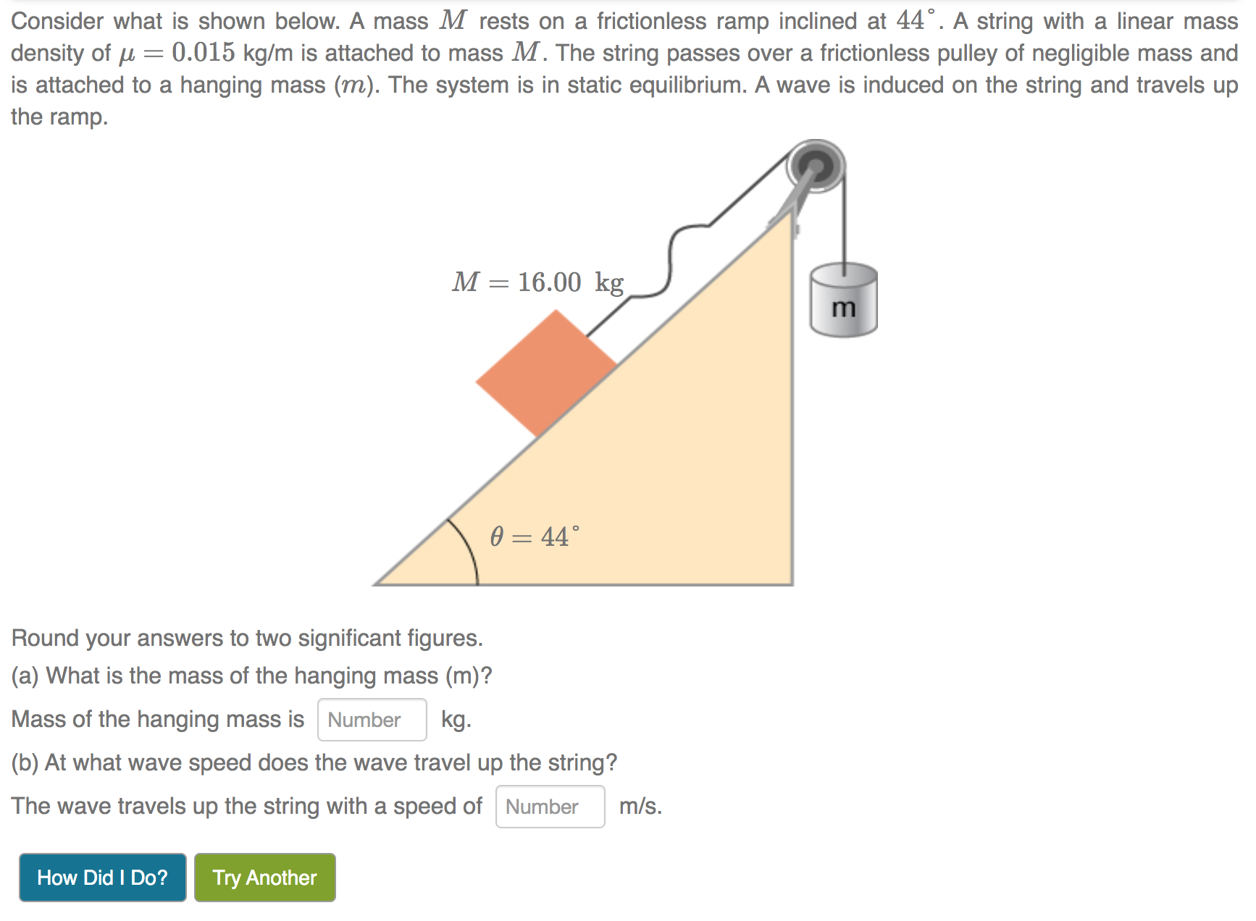
Algorithmic Randomization
Algorithm generates a new set of values for variables...
in the question text, diagram and in the fully worked out solution
Back
Notes:
Questions that use algorithmic randomization allow you to try a question several times with different values.
When you press “Try Another” button, the algorithm generates a new set of values (circled in red here)
They will automatically update in the text of the question, in the diagram and in the fully worked out solution that a student sees after pressing “How Did I do?”
Algorithms can be used in almost every question type we have to offer (even true/false, multiple choice, etc.).
Algorithms enable an instructor to provide limitless practice opportunities for students, as well as reduce cheating by giving different versions of an assignment to everyone in a class.

Slide 10
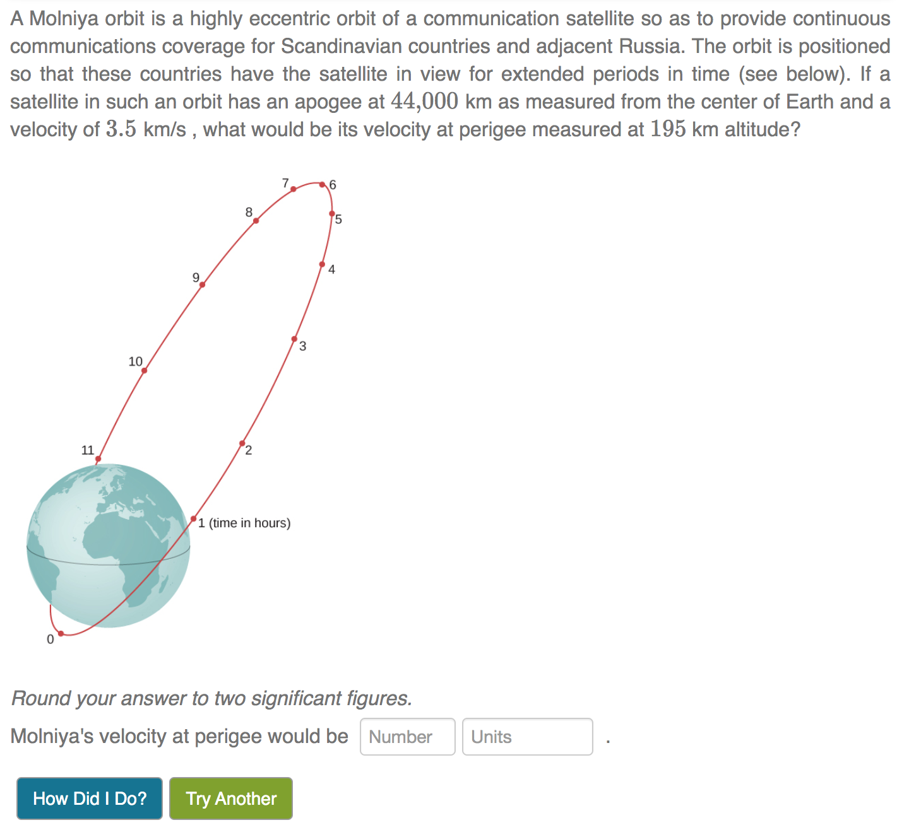
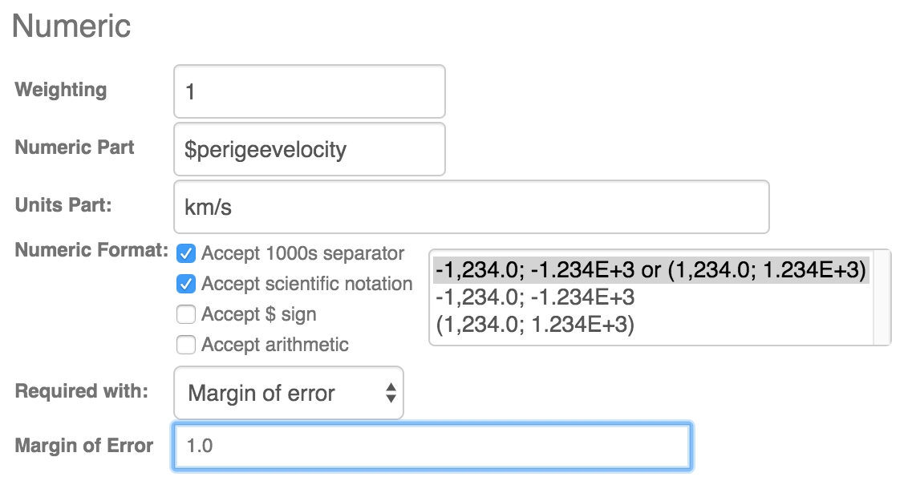
Numeric Questions: Units, Tolerance
Back
Notes:
These questions require a response that includes a number and units.
Options/Features
System understands physical equivalents: for example, 50cm equals 0.5m
Equivalent units are programmable at the level of question banks, to allow for discipline-specific requirements.
Grading can be set to:
Exact match
Exact match to significant figures
Static tolerance
Tolerance in n-th digit
Percent tolerance
Options to accept:
Thousands separators
Scientific notation
Arithmetic
Dollar signs

Slide 11
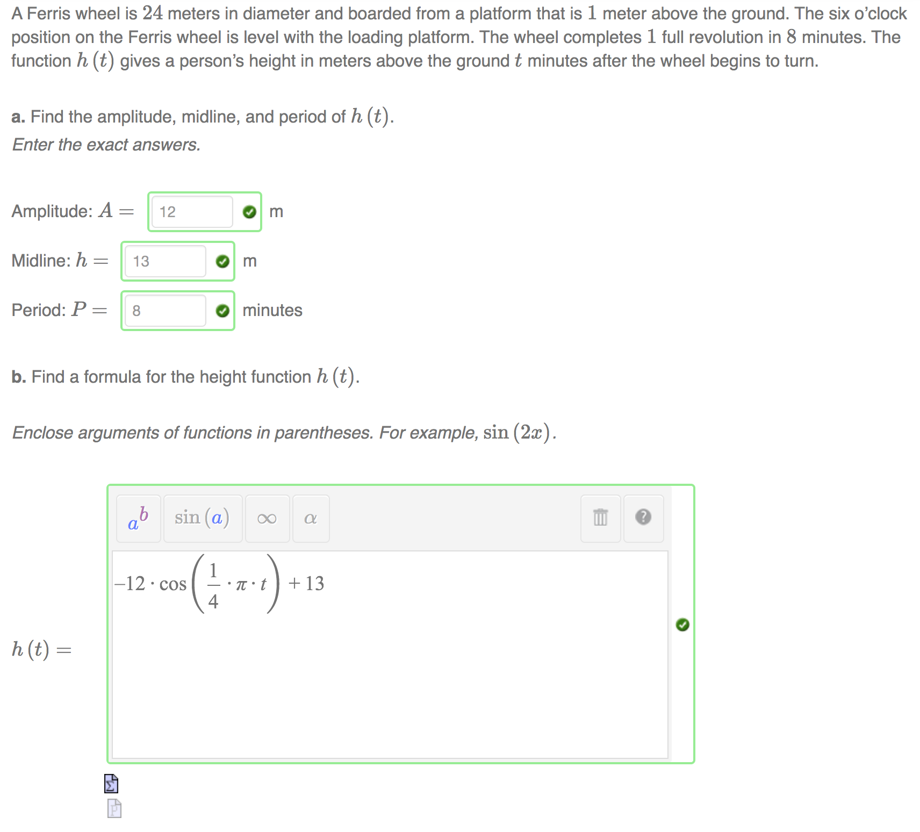
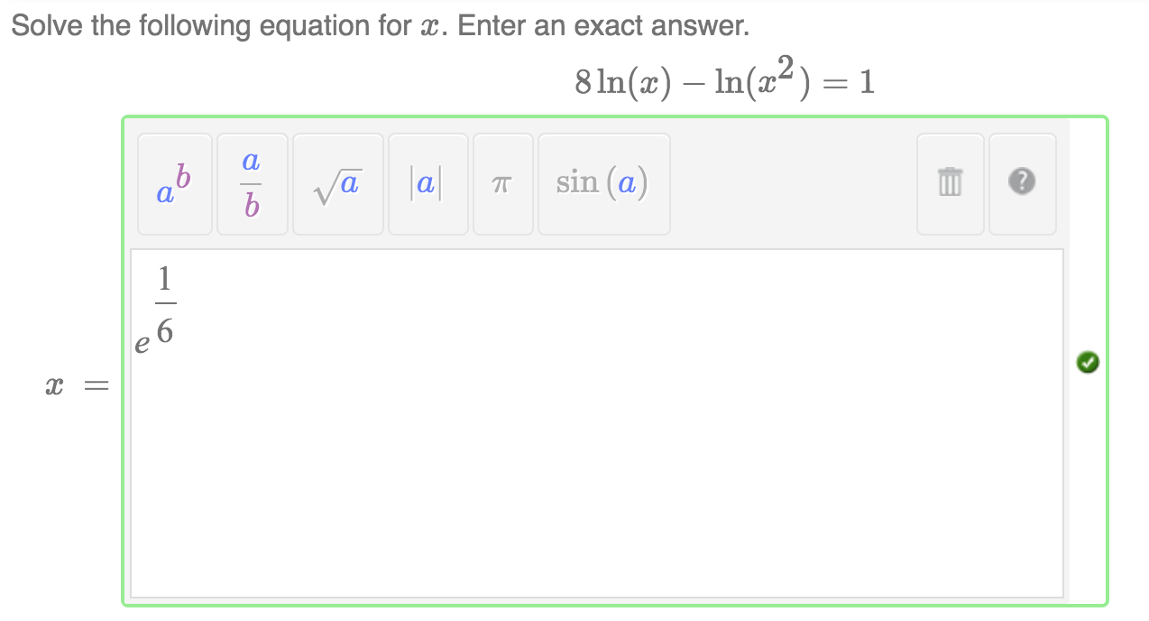
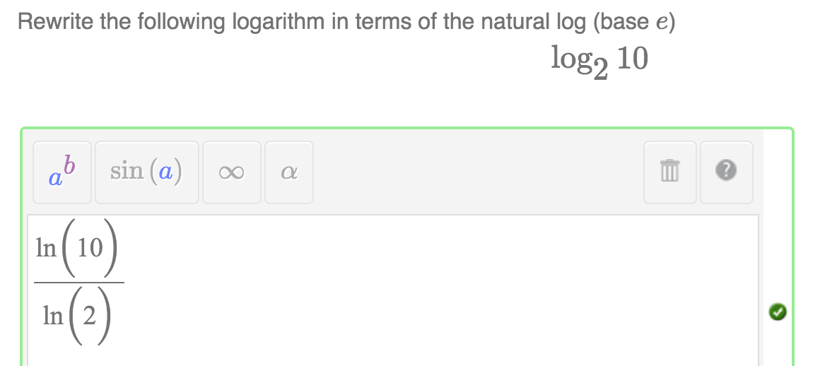
Trigonometry, Logarithms and Exponentials
Back
Notes:
Möbius works with all types of mathematics, including trigonometry, logarithms, and exponentials.
These can be graded for math equivalency, which other systems struggle with.
For example, sin^2(x) + cos^2(x) = 1 = cos(x)*tan(x)/sin(x)

Slide 12
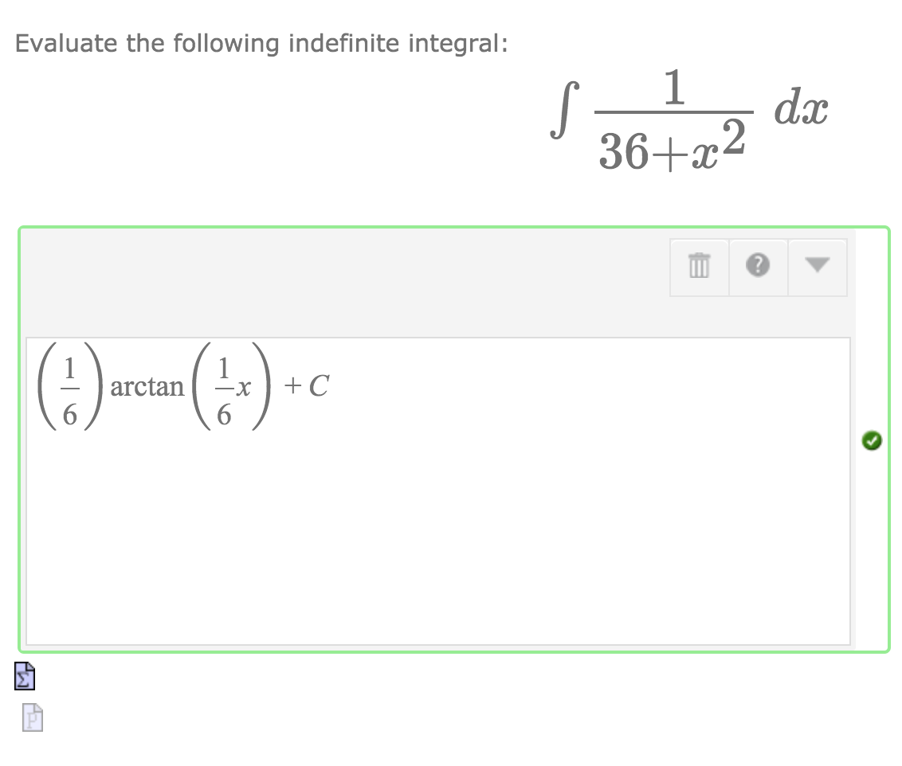
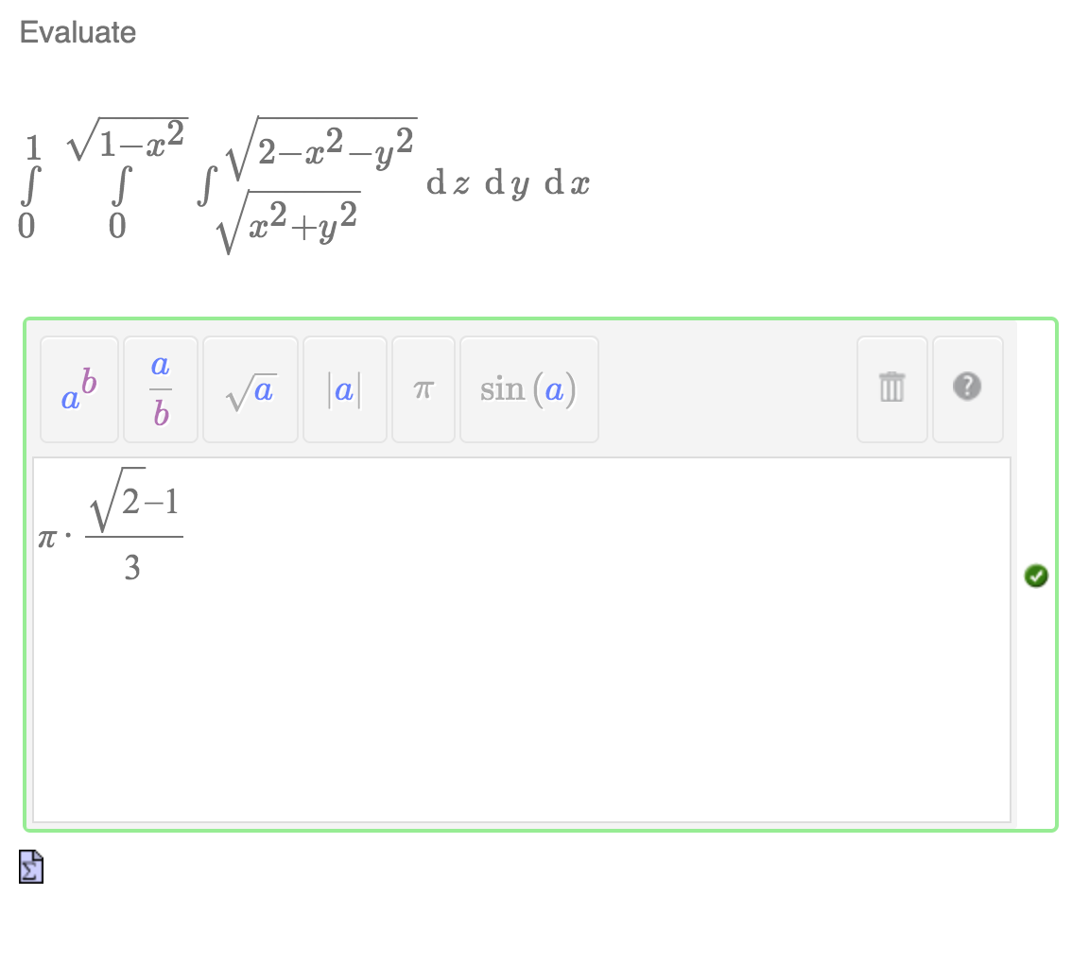
Integrals
Back
Notes:
With Möbius, you can ask for the answer to an integral, whether the answer is a simple numeric answer or a more complicated math expression.
You can also have students set up an integral and then solve it.

Slide 13
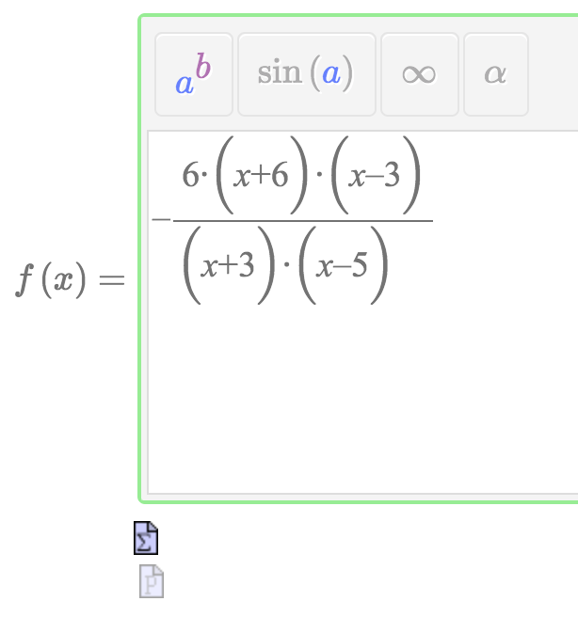
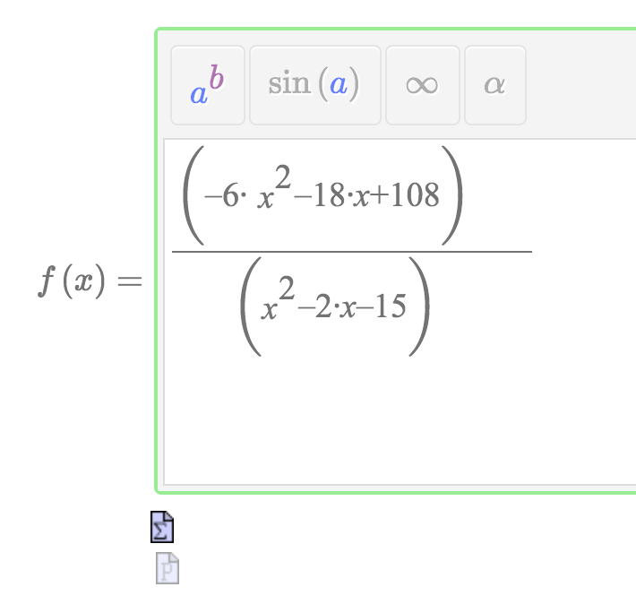
Mathematical Equivalence
Both simplified and expanded forms get marked ‘Correct’
Back
Notes:
Equivalent: Möbius has many comparison routines and can test for equivalence in different ways, depending on the topic/question and what answers should be considered correct.

Slide 14
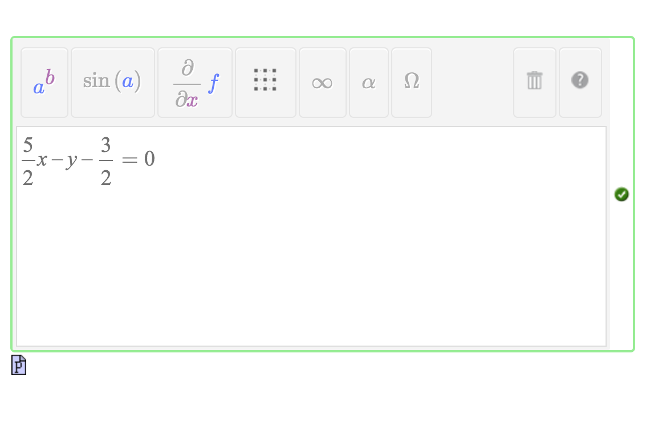
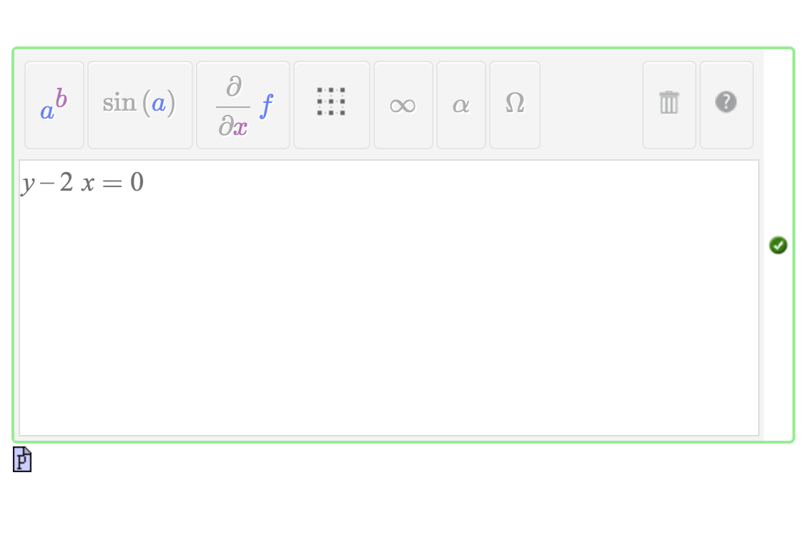
Open Response Math Questions
Back
Notes:
Can ask questions like “Give an example of …” instead of only questions that have one specific answer or a couple of possible forms. For example, “Give the equation for a line that goes through the point (3,6).”

Slide 15
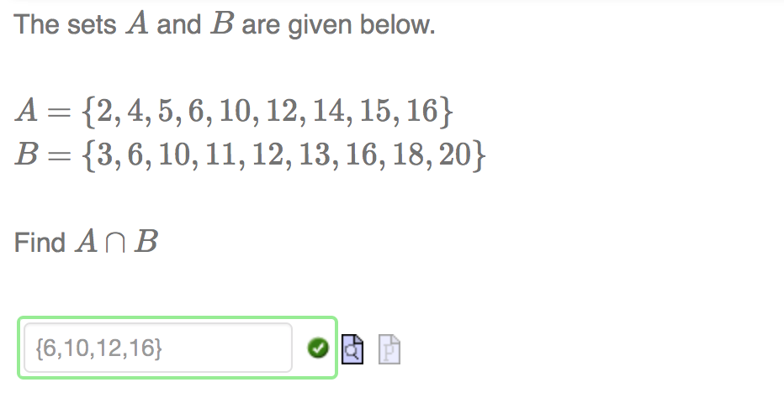
Other Mathematical Constructs
Back
Notes:
Möbius understands mathematical language and constructs, like sets (unordered) and lists (ordered), vectors and matrices.
The power of the math engine can also be used for higher level math topics like statistical distributions and Tensors.

Slide 16
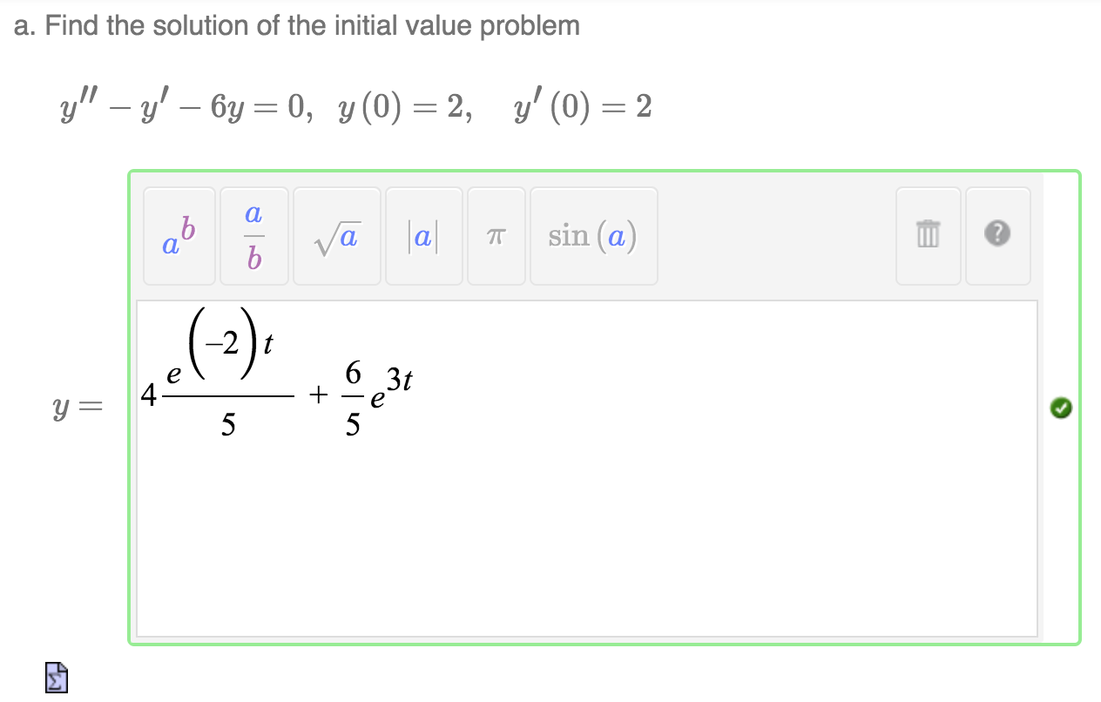
Differential Equations
Back
Notes:
Differential equations can be entered in either of the traditional formats (using differentials or primes).
You can ask students to solve general differential equations, as well as initial value problems.

Slide 17
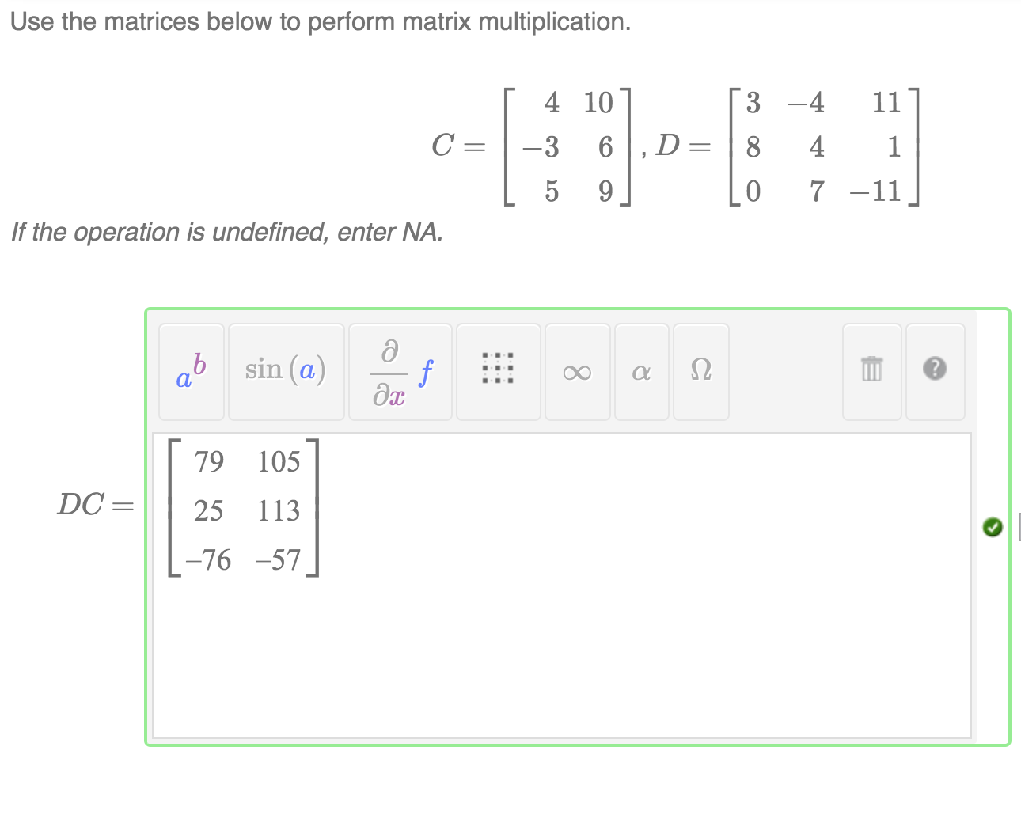
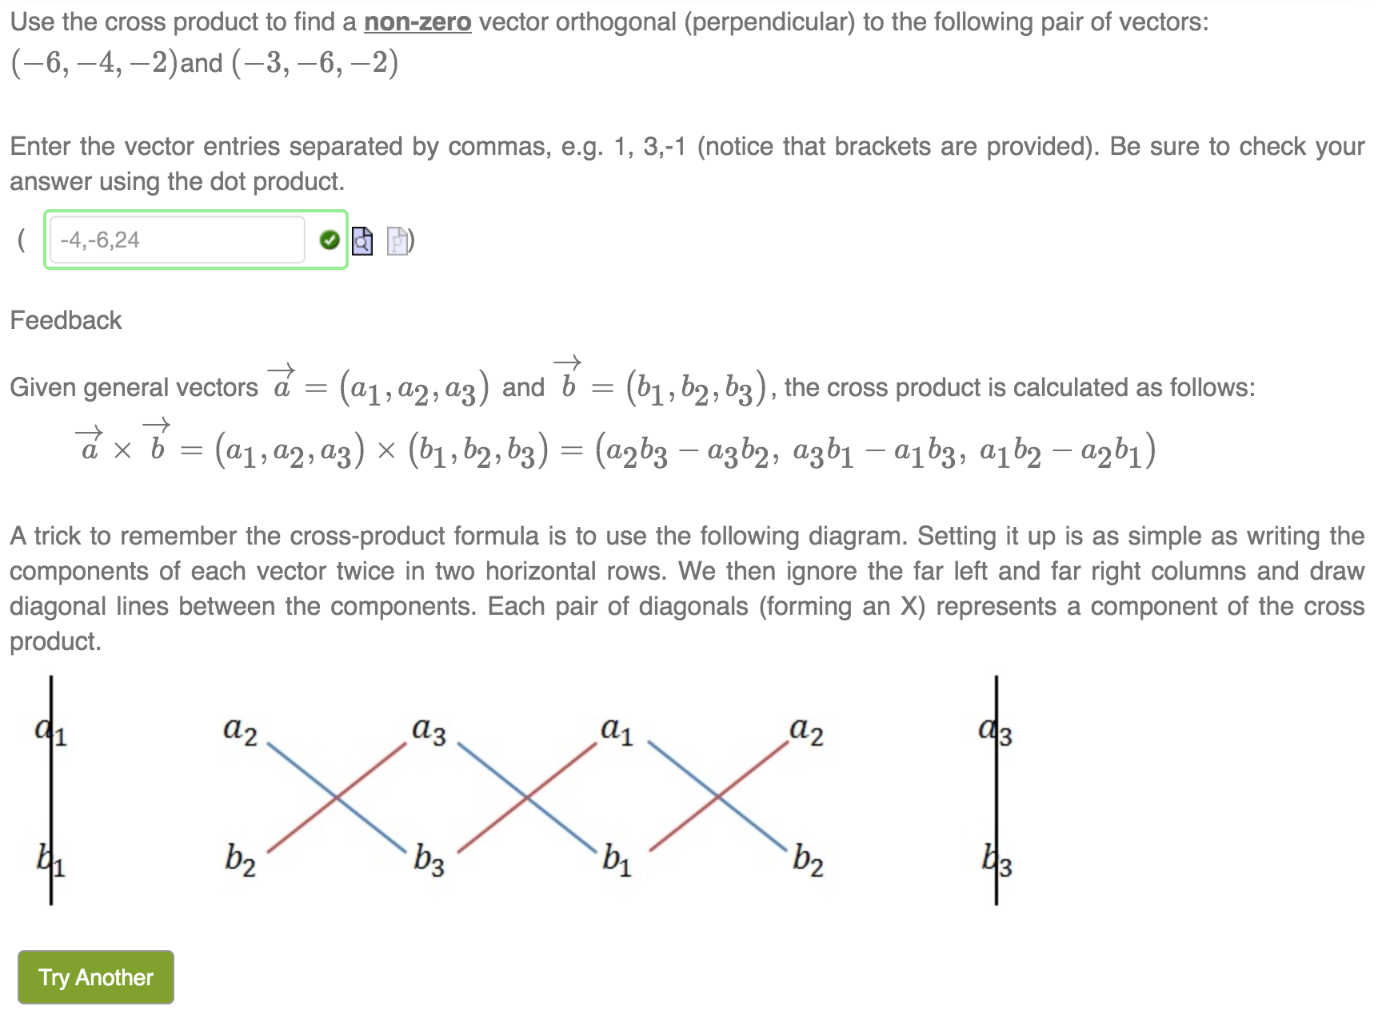
Matrix & Vector Operations
Back
Notes:
Möbius understands mathematical language and constructs, like vectors and matrices.
You can ask students to perform calculations (like taking the determinant or multiplying matrices, or taking the dot or cross product of vectors) and the system can grade it automatically.

Slide 18
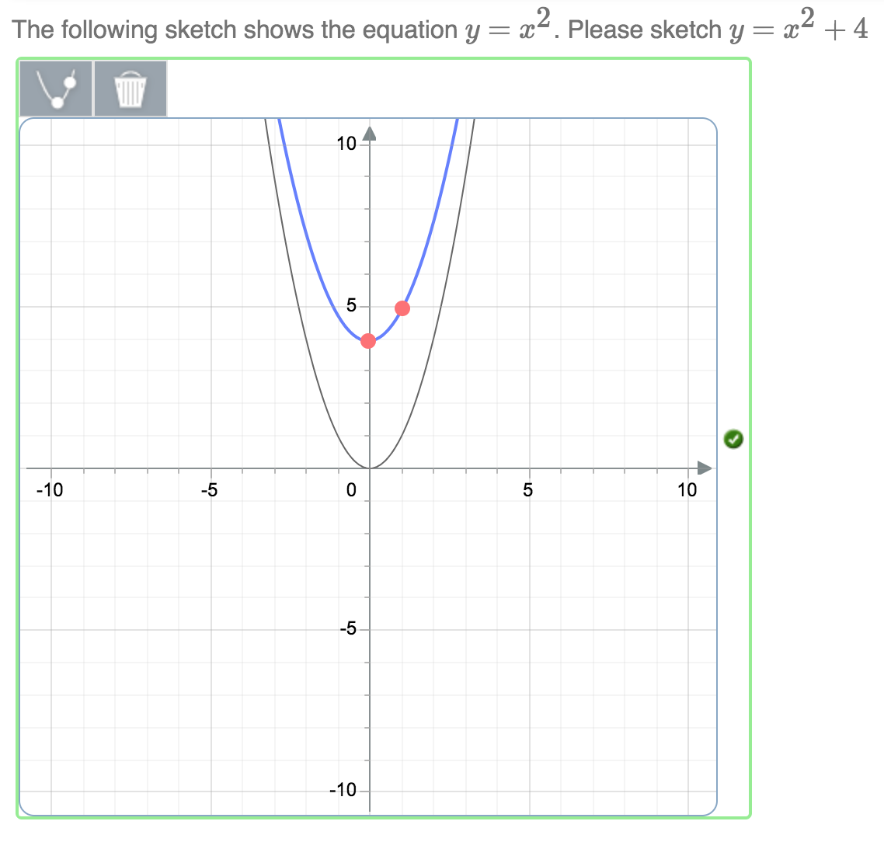
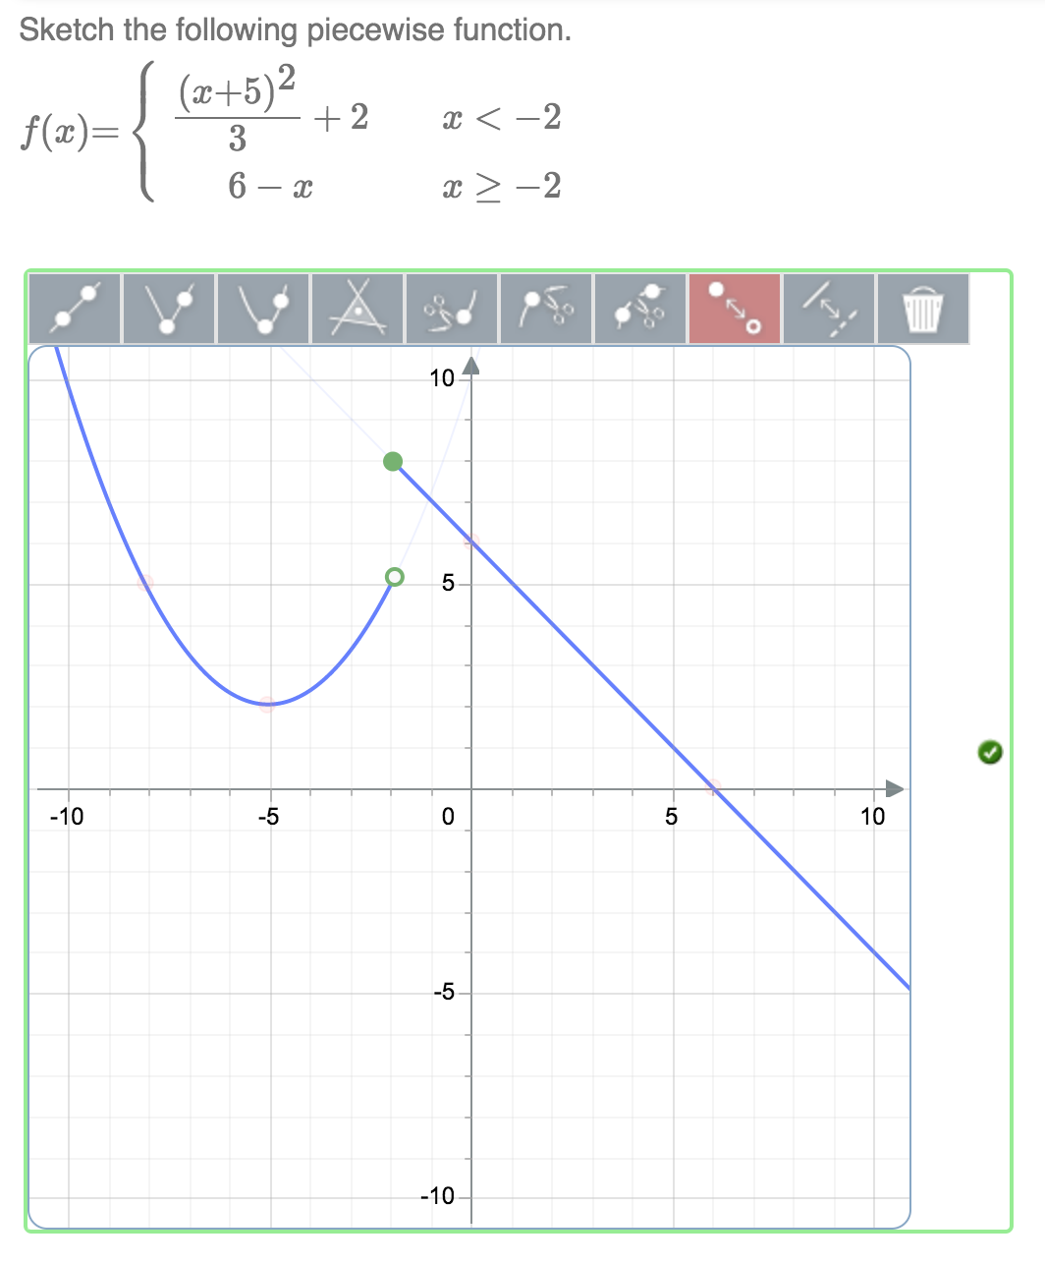
Plots: Sketching Question Type
Back
Notes:
Students use a set of graphical sketching tools to plot mathematical expressions including:
Lines
Absolute values
Parabolas
Logarithms
Exponentials
Intervals
(Systems of) Inequalities
Piecewise functions
Options/Features
Visibility of buttons can be toggled individually
Built-in tolerance
Background functions

Slide 19
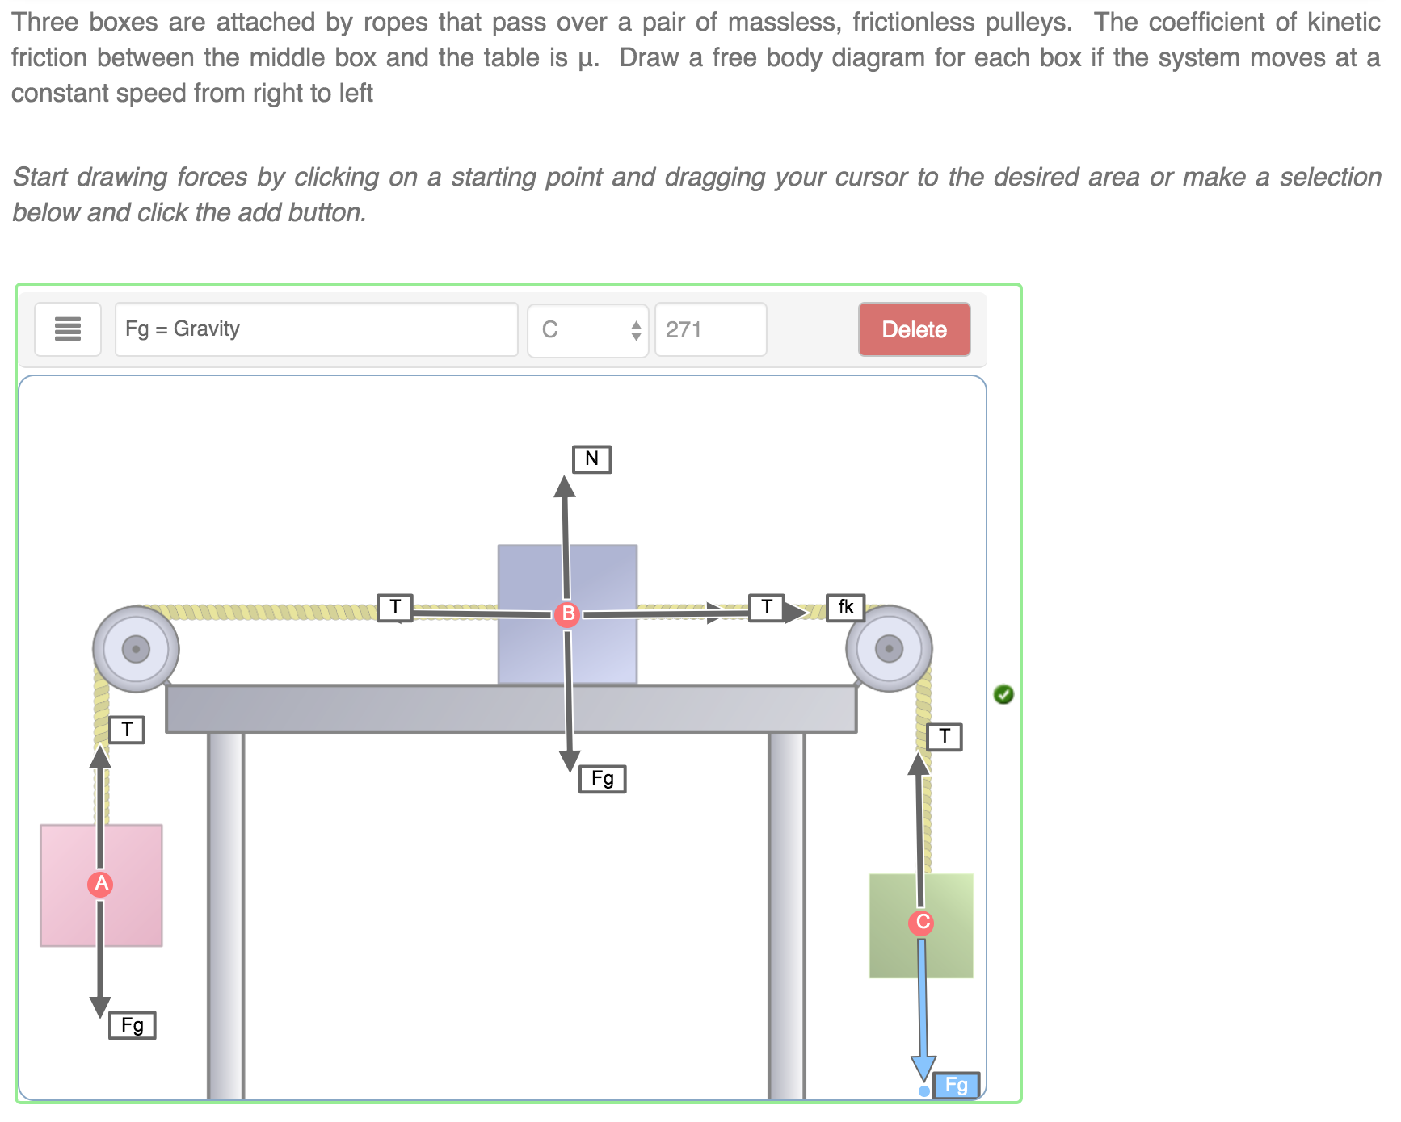
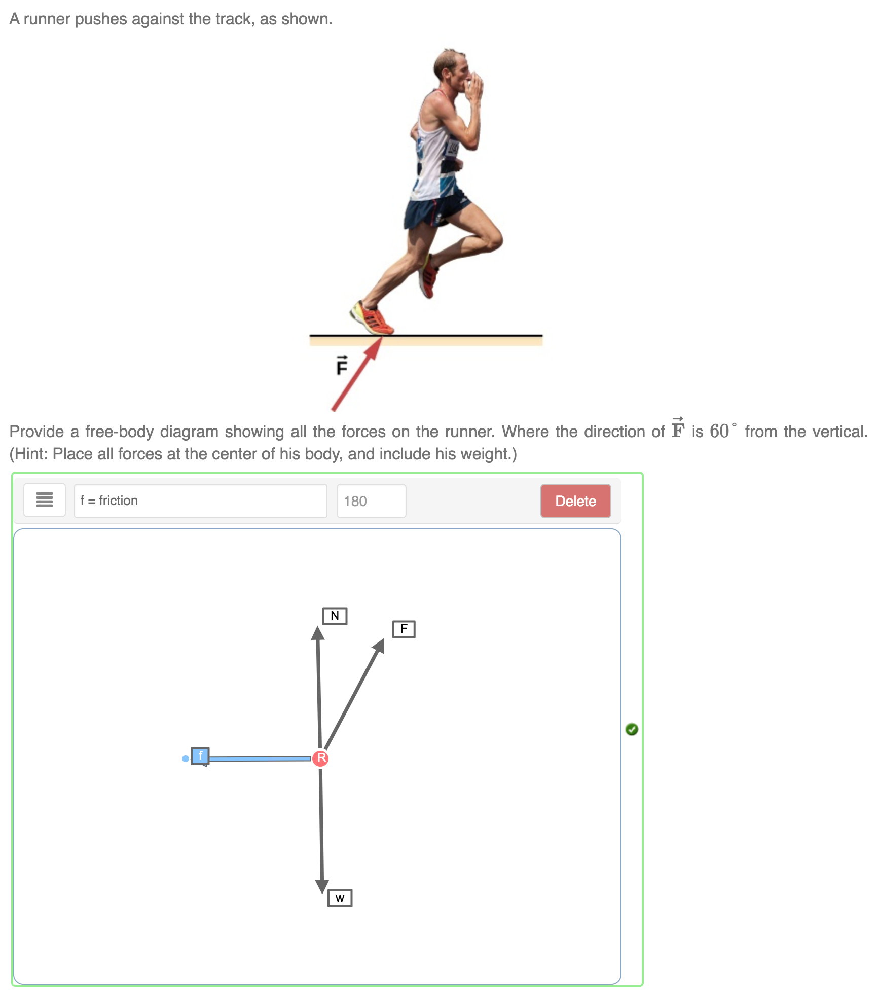
Free Body Diagrams
Back
Notes:
Students use a graphical interface to add forces to free body diagrams.
Options/Features
Customizable angular tolerance
Customizable list of forces
Unlimited control points

Slide 20
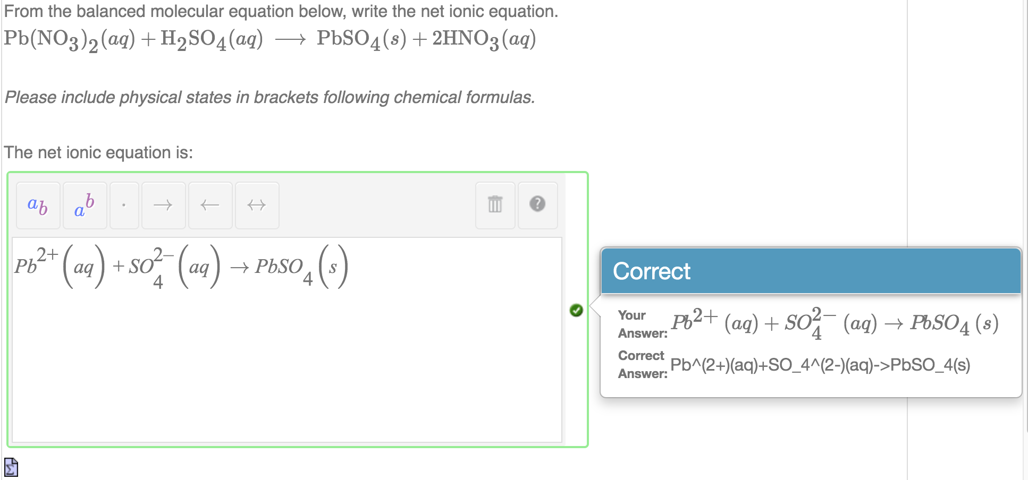
Chemical Formulas & Equations
Back
Notes:
Mathematical Formula (Chemical Formula subtype) question type allows grading of chemical formulas and reactions (equations).
The reactions can include state, as well as ionic charges.
Mobius understands that compounds can be entered in different order on reactant or product side.

Slide 21
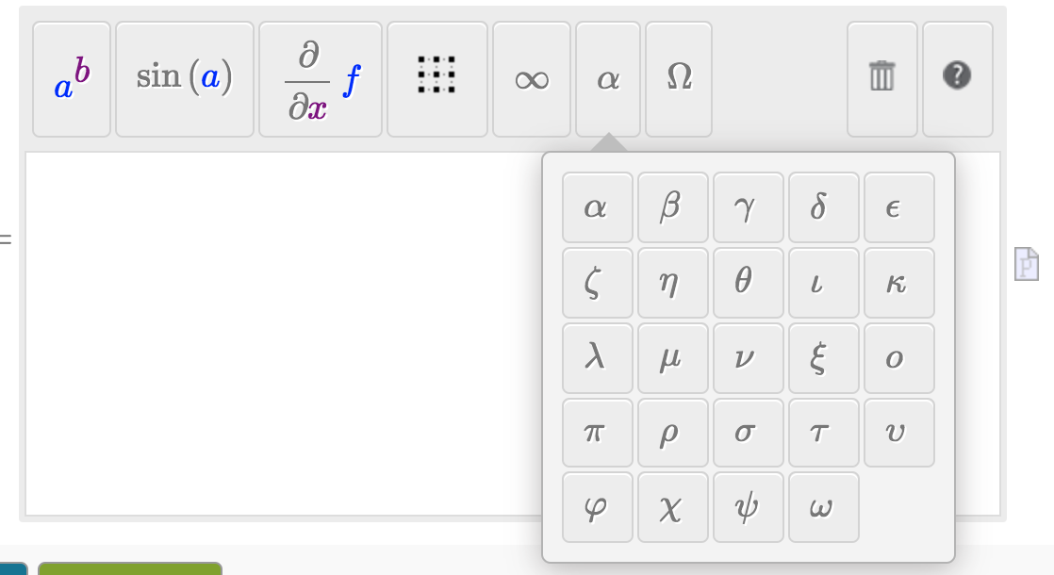
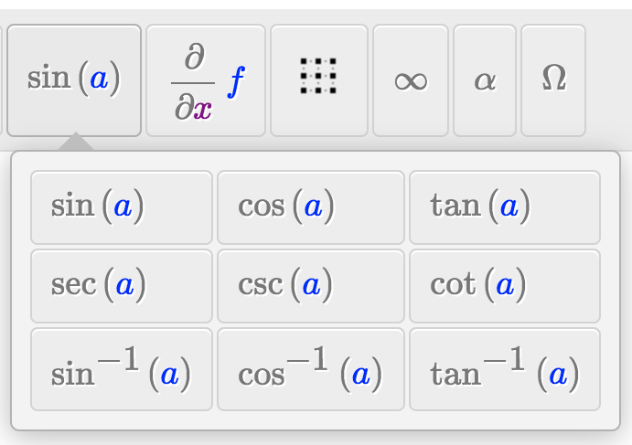
Equation Editor & Palettes
Back
Notes:
A variety of palettes are available in the equation editor, allowing students’ input for questions in Algebra, Trigonometry, Calculus, Differential Equations, Linear Algebra, Chemistry and Physics.

Slide 22
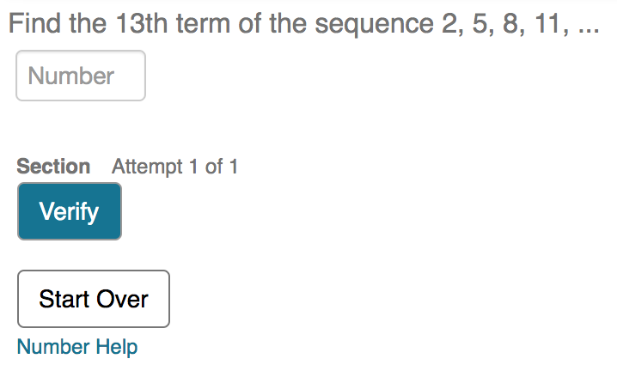
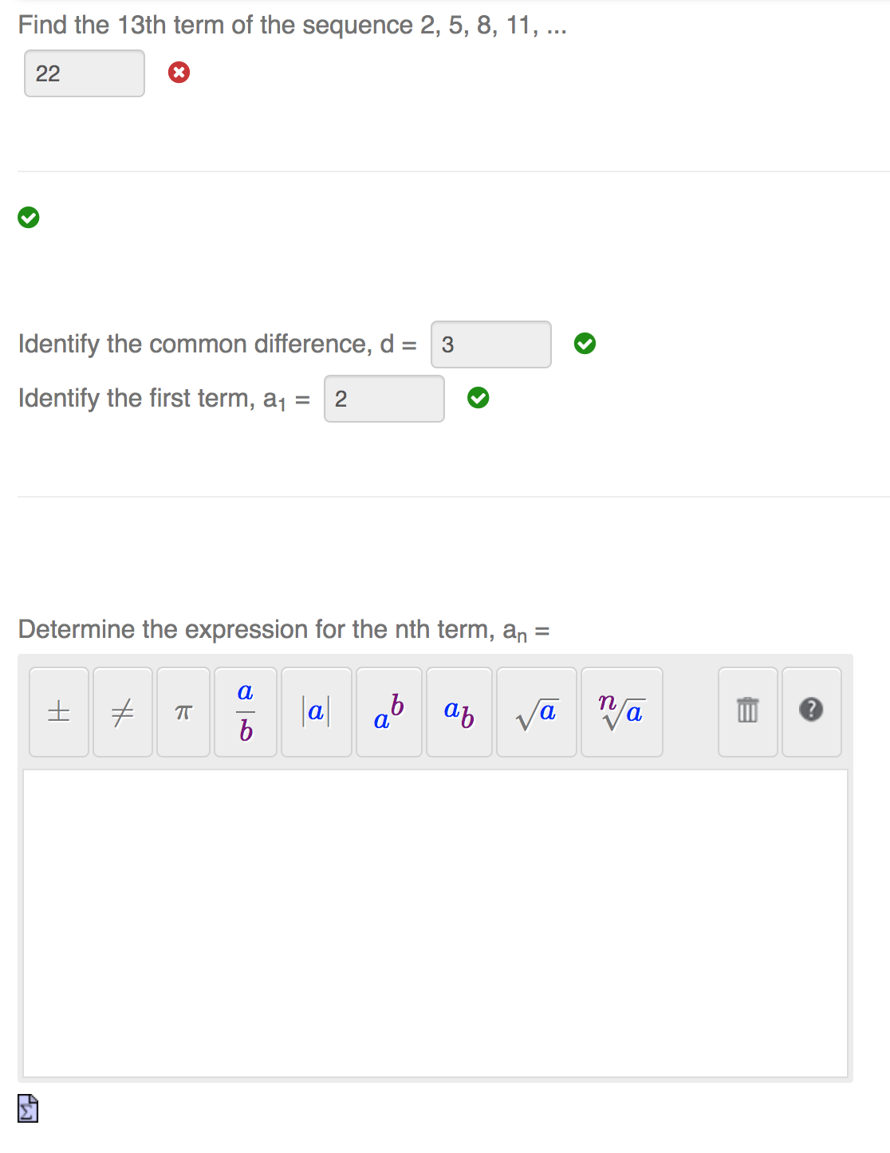
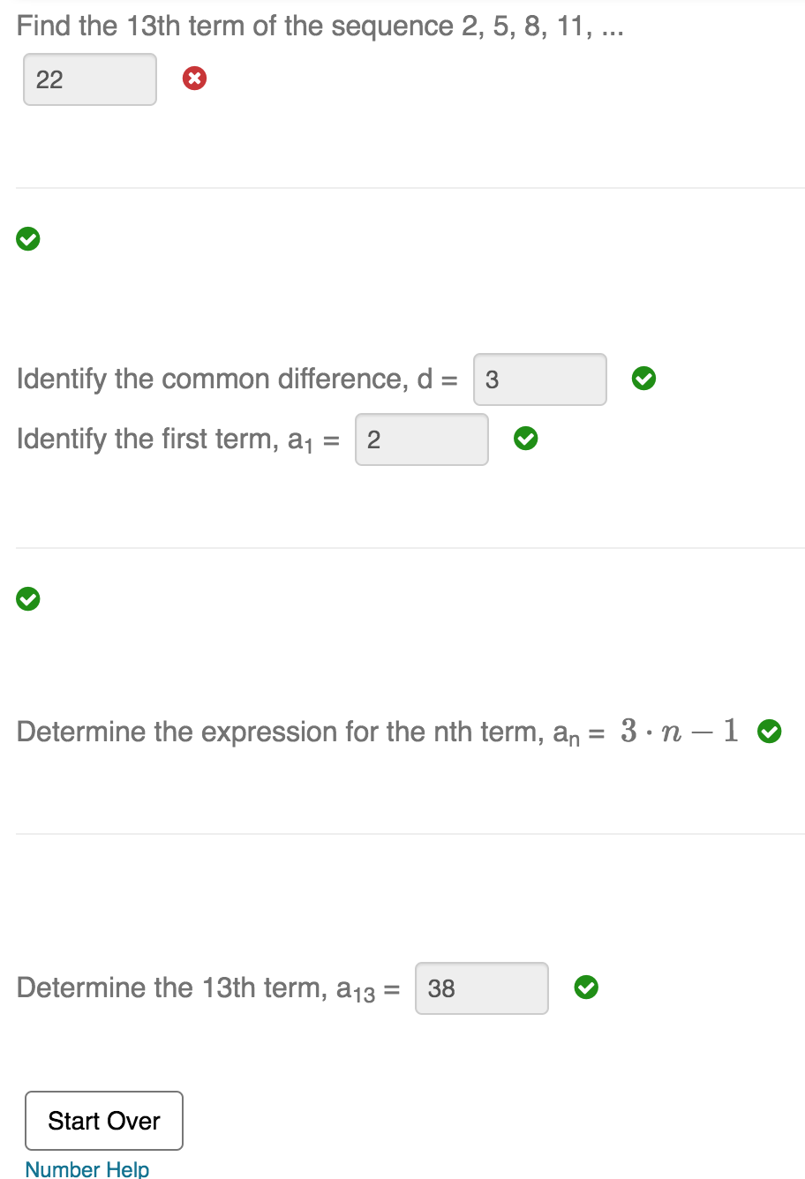
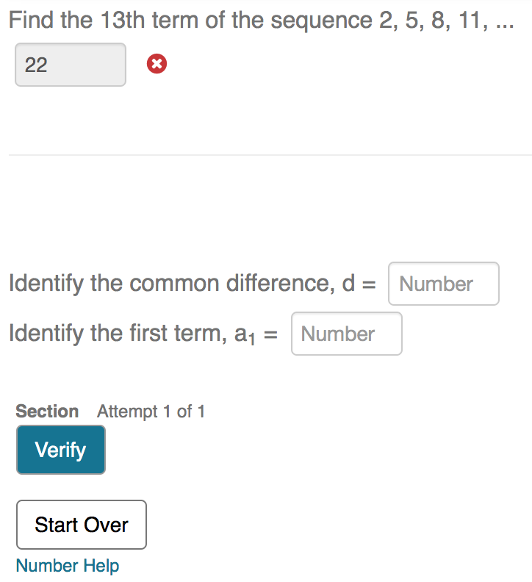
Adaptive Questions
Back
Notes:
An adaptive question can contain any combination of response areas and content. Progress through the question can be controlled by a student's success in preceding sections.
In this case, a wrong answer triggers a step-by-step walk-through of the problem.

Slide 23
Thank-you

