Slide 1
Recent developments in the use of maths e.g.
– using e-assessment in the learning process
Martin Greenhow, Brunel University

Slide 2
Maths e.g. at Brunel University
http://www.mathcentre.ac.uk:8081/mathseg/
Questions database spans GCSE, A-level, undergraduate topics, ADULT LEARNERS/employability aptitude
>~5000 ‘question spaces’ in the database span MC, NI, RNI, PNI, TFU, MR, NI+confidence, Revealed MC, drag&drop etc. NEW a statement selection question SS (no free-form maths input … yet): PROS/CONS?
About 1500 users take circa 30,000 tests p.a. Students from Maths, Economics, Electrical and Electronic Engineering, Computing, Foundations of Engineering, Foundations of IT, PGCE and Sports Science, even MSc student diagnostics. Much commonality. NEW BioMaths questions

Slide 3
Commonality – a European engineering syllabus
Core content
Set union, intersection, difference and complement. Existence and universal quantifiers. Direct and indirect proof, proof by induction.
Definition of a function. Monotonicity of a function. Inverse function and combined function. Properties of basic functions. Hyperbolic functions and their inverses.
Complex numbers and their basic properties (sum, difference, product, quotient, conjugate and modulus), presenting and calculating complex numbers both in coordinate form and polar form, complex roots.
Limit and continuity of a function. One-sided and improper limits, l'Hospital's rule.
Derivative as limit of difference quotient. Differentiating basic functions, products and quotients, chain rule. Studying the values and extrema of a function based on derivatives..
Basics of integral calculus.
Complementary knowledge
Preimage, injection, surjection, bijection. Roots of real valued polynomials, factorisation.
Sandwich principle. Intermediate value theorem, continuity of inverse function.
Derivative of inverse function, linear approximations.
Applications of integral, like area and volume.
Specialist knowledge
Mean value theorem.
Done
Impossible
MG on the case

Slide 4
CAA in practice
Low-stakes summative assessment - invigilated or not. Weekly or fortnightly tests. Pre and post tutorials but NO lectures.
Preferred scheme: best-ever mark from their first 5 attempts counts towards their module mark; not invigilated and group work is allowed/encouraged. Exam pass required!
Mostly we aim to promote learning/confidence … we don’t really need more marks!
Benchmark against other students? Grand wizards.

Slide 5
Maths for Economics year-on-year results (% in grade/% mark) circa 600,000 questions done

Slide 6
What happened next?
Covid -19!
CAA exams with randoms essential
Cheating (aliasing/using illegal software e.g. Wolfram alpha, Excel)
so upload their workings - do it!!!!!
The last two years’ worth of bars on the chart are somewhat bonkers!
About half the students got an A … about the same number of F’s as in previous years (some students are determined to fail!)

Slide 7
What should happen next?
I retire next month (but maths e.g. will continue) so here’s a couple of questions for everyone to consider so you can set better tests a priori:
How difficult is a question? Operation count (no),
difficulty of concepts(?), question entropy (possible?)
How discriminating is a question? – no idea!
See Effective computer-aided assessment of mathematics; principles, practice and results
Teaching Mathematics and its Applications, Volume 34, Issue 3, September 2015,
https://doi.org/10.1093/teamat/hrv012

Slide 8
Cancel fractions
ln(5)
umbers
ln(3)
on
ln (3)
ln(3375)
Indices>
ln(5)
ln(5)
ln(3)
More difficult if integration limits are negative and/or right -> left

Slide 9
Cancel fractions
ln(5)
Is this a measure of difficulty?
Sub numbers
ln(3)
Definiteotation
ln (3)
ln(139968000)
ln(15)
Power laws
ln(16)
Factorise
ln(5)
Mult fractions
ln(12)
Subtract fractions
ln(18)
ln(2)
Meaning of index < 0
ln(3)
ln(2)
What does this mean?
Rank ordering ok
(according to the data)
Ratio of entropies = 2.3

Slide 10
What should happen next?
A taxonomy of errors!
See Effective computer-aided assessment of mathematics; principles, practice and results
Teaching Mathematics and its Applications, Volume 34, Issue 3, September 2015,
https://doi.org/10.1093/teamat/hrv012

Slide 11
Reverse engineering
But do we want them to do this?
Will they use Wolfram alpha? Yep!

Slide 12
Feedback
same randomisation
Question - parameters
all randomised
Students mimic the feedback
in exam scripts

Slide 13
Preferable? TF(U) question
Tests understanding (I think …)
This question context (not fully shown) makes it clear that k > 0
What if k, R or S < 0 ? Very much harder!

Slide 14
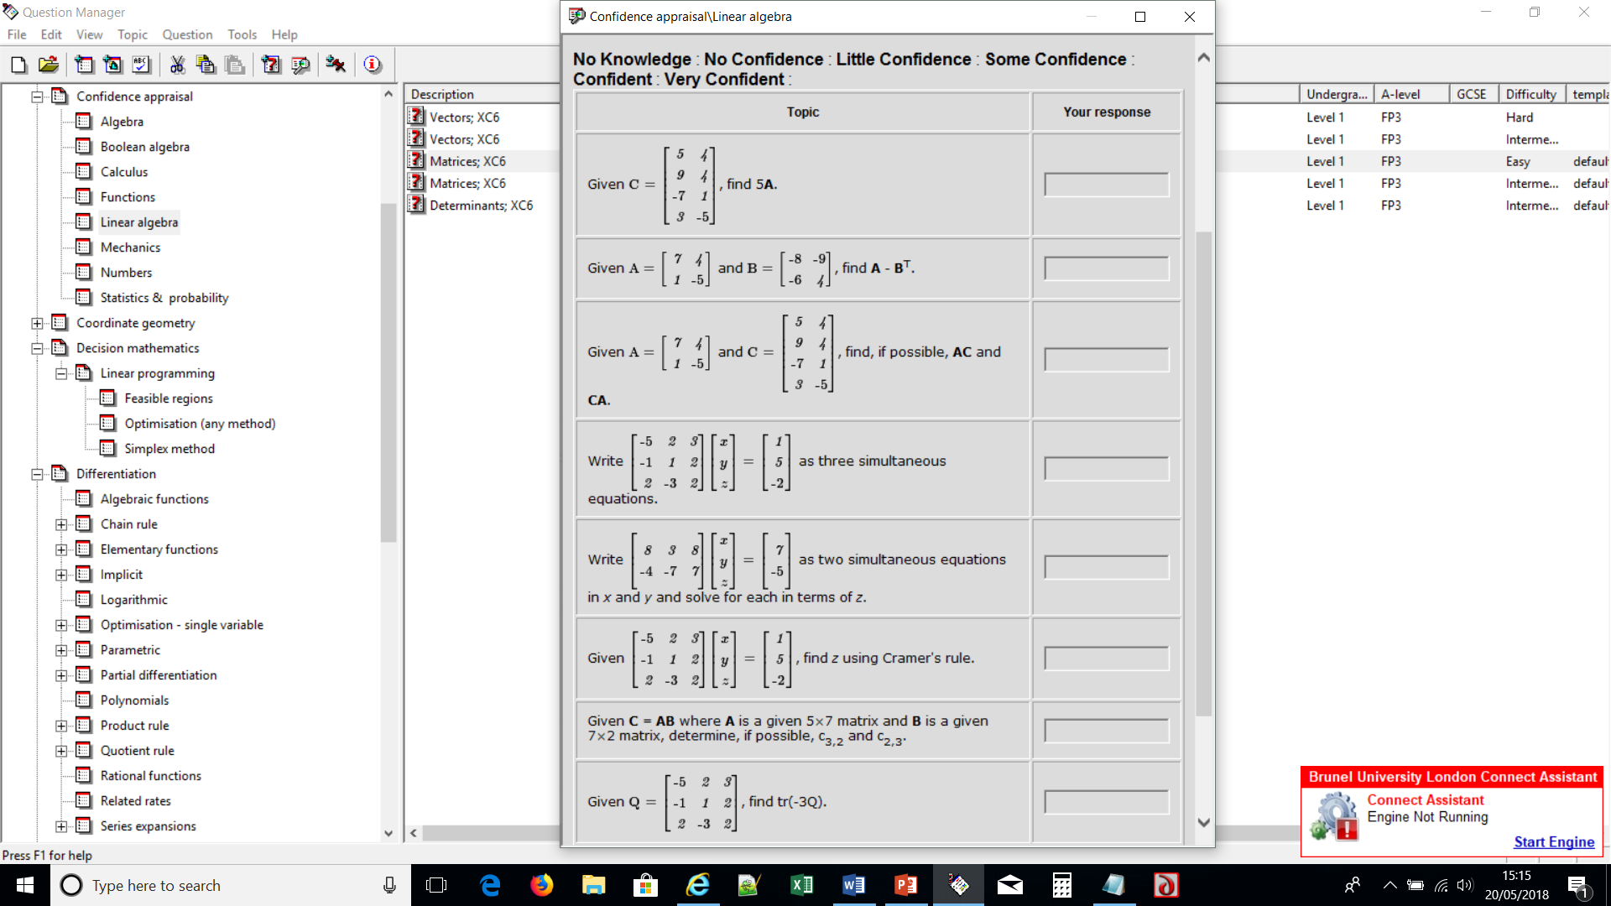
Could use in breakout rooms?

Slide 15
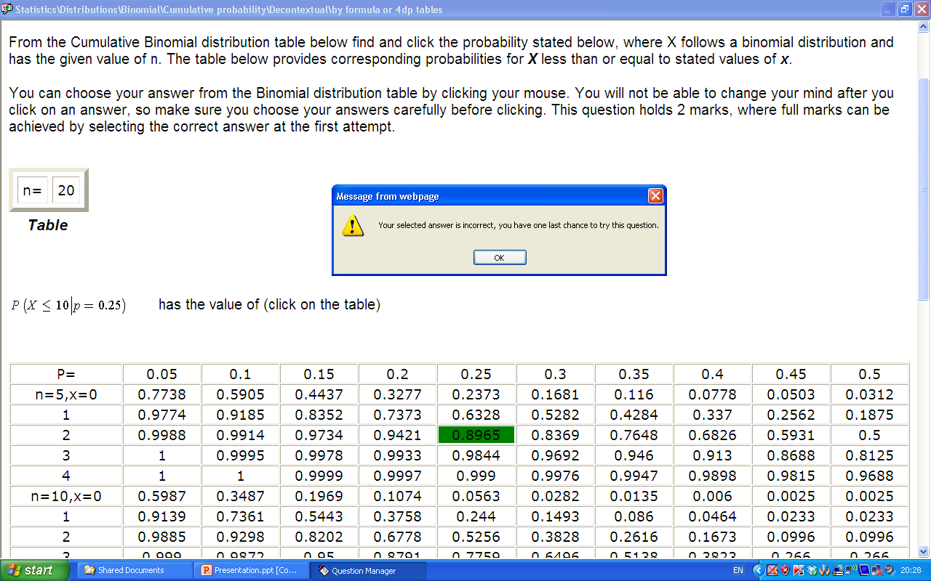
A statistics question - tables, tools or formula?

Slide 16
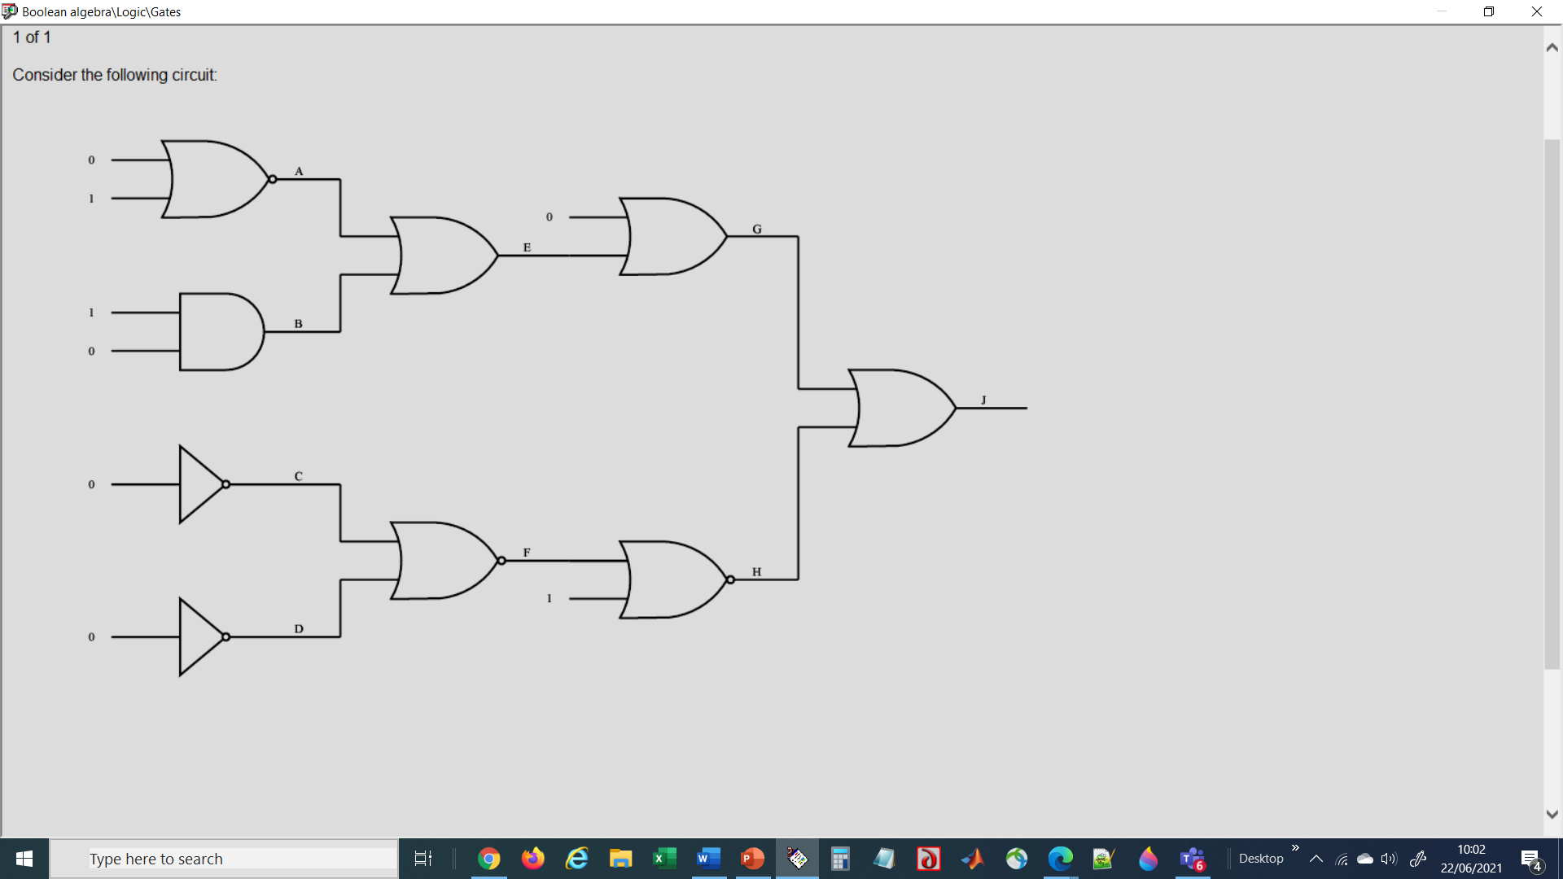
A logic question – more straightforward?

Slide 17
A new question type
In the question test, MUST can be replaced by ‘may’, ‘must not’

Slide 18
Not been used yet but coding is done
corrects_ref = new Array("","All non-zero rows are above any rows of all zeros.",
"Each leading entry of a row is in a column to the right of the leading entry of the row above it.",
"All entries in a column below a leading entry are zero.") … definition of row echelon form
wrongs_ref = new Array("","The leading entry in each non-zero row is 1.",
"Each leading 1 is the only non-zero entry in its column.",
"All non-zero rows are below any rows of all zeros.“,
"Each leading entry of a row is in a column to the left of the leading entry of the row above it.",
"Each leading entry of a row is in the same column or a column to the right of the leading entry of the
row above it.",
"All entries in a column below a leading entry are non-zero.",
"All entries in a column below a leading entry are smaller than the leading entry.",
"The absolute value of all entries in a column below a leading entry are smaller than absolute value
of the leading entry.",
"The matrix must be square.",
"The number of rows must be less than or equal to the number of columns.",
"The number of columns must be less than or equal to the number of rows.");
So all that’s needed is teaching experience!

Slide 19
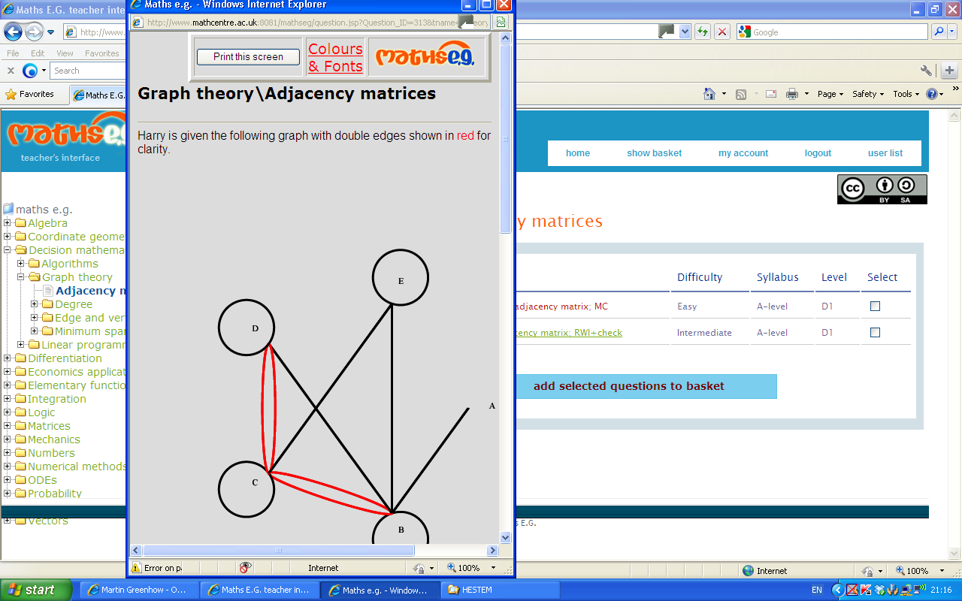
Teacher interface – shop on Amazon?

Slide 20
Javascript, MathML and SVG provide a rich environment for setting objective questions
Positive effects on students’ perceptions and on exam performances
Widely applicable database of questions
Good source of reverse-engineered questions for all, especially teachers
Maths e.g. Try it at:
http://www.mathcentre.ac.uk:8081/mathseg/
http://www.mathcentre.ac.uk:8081/mathsegteacher/
works on all browsers, PC & Mac, I-pads and smart phones, no link to VLEs yet!

Slide 21
Where are we going with all this? Can we get systems to share or work together? Maybe not! But you can still ‘steal’ what is useful and view the source code too. Future-proofing? Yes, so far! Maths e.g.’s legacy may be more as a learning resource (certainly how students use the feedback)

Slide 22
What we can all do right now (this afternoon!) Link individual questions to any other learning material that supports links e.g. add ‘Try one yourself’ button to open question/feedback in a new window.

Slide 24
What we can also do right now (this afternoon!) Link individual TOPICs to any other learning material that supports links e.g. add ‘Try one yourself’ button to open all questions in a topic in new window

Slide 25
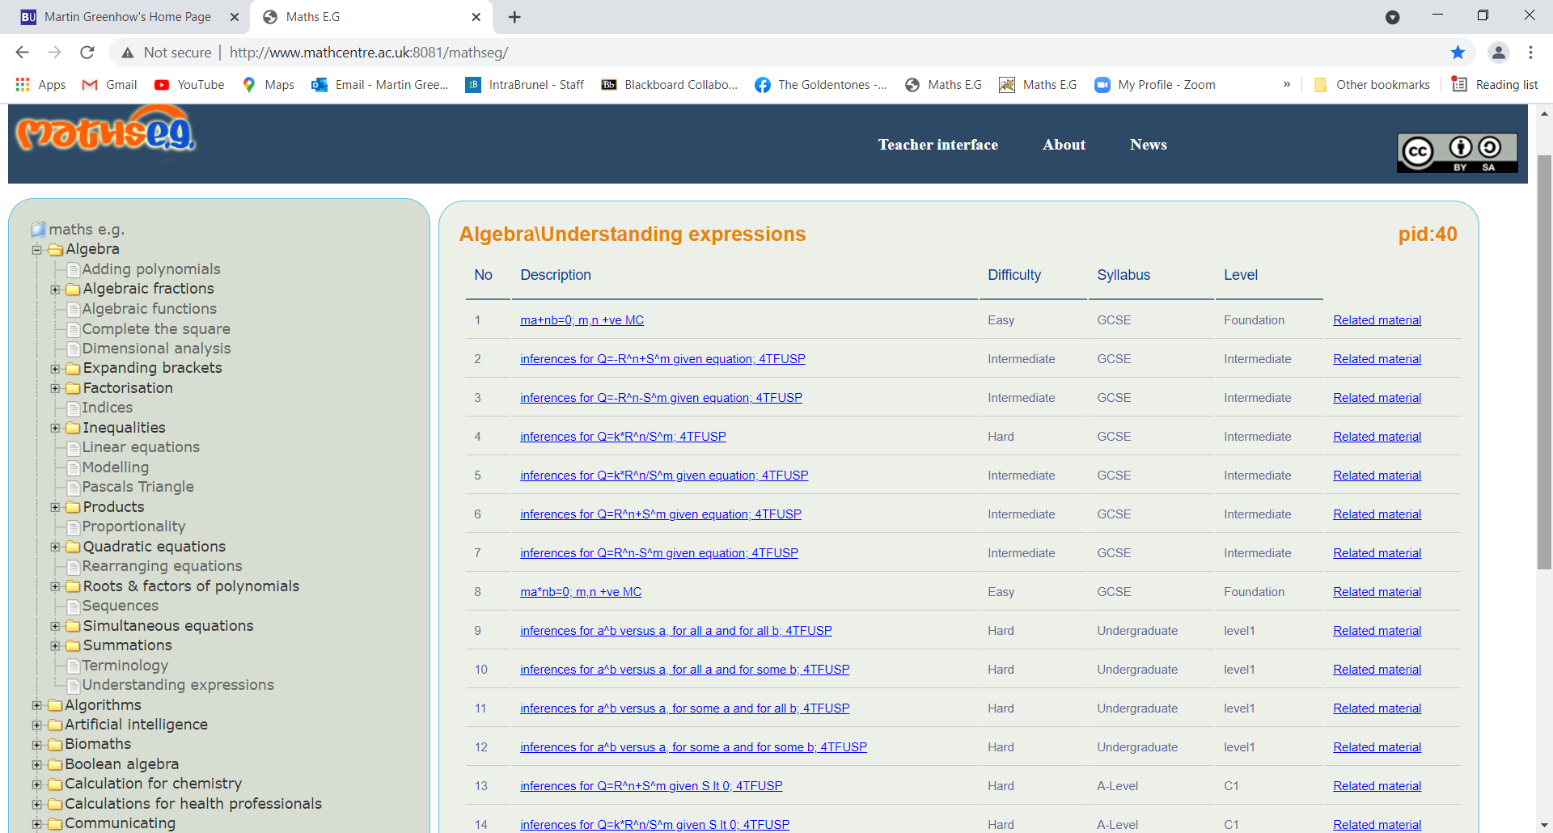
http://www.mathcentre.ac.uk:8081/mathseg/topic.jsp?pid=40

Slide 26
Or link to whole tests you have created - CHECK, CHECK, CHECK! (VLE issue) ... but I am not going to provide tests since I’d never include what you want and also issues of privacy (so no Mathematics for Dogs and Cats)
Finally take what you want, including code,
… and tell me what’s missing (no promises!)
Let’s share.
Good luck!
martin.greenhow@brunel.ac.uk
martin.greenhow1@outlook.com

