Slide 1
SPIRIT Maths
Students’ Perceptions Informing and Redefining Innovative Teaching of
Mathematics in Higher Education
Dr Violeta Morari, Dr Clodagh Carroll
Department of Mathematics
Munster Technological University
Ireland
www.spiritmaths.com

Slide 2
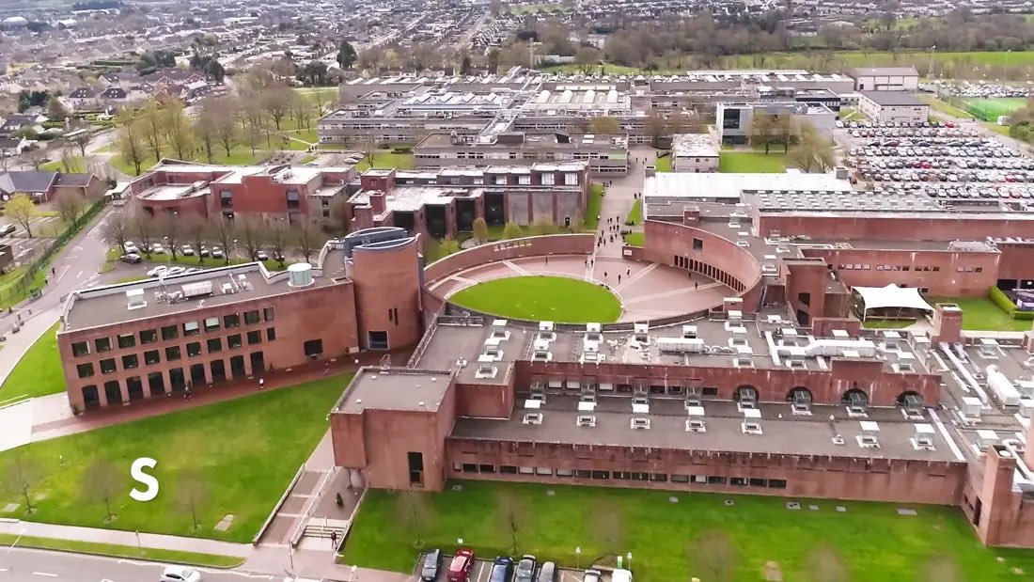
Background & motivation
MTU: 6 campuses; over 100 degree programmes; 18,000 students.
Mathematics is a service department to other (applied) disciplines.
Typical degree programme at MTU: 6 × 5 credit modules.
Students are assessed in all 6 modules, hence a heavy assessment schedule.
A typical maths module: 3h lectures + 1h tutorial/lab + 3h of independent learning per week.
Many students work part-time jobs.

Slide 3
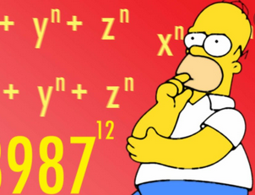
Centrality of Mathematics in MTU
Numbers (2021)
Total of 3169 first year students in MTU
Out of 120 programmes in MTU 81 include at least one maths/stats module
2260 (71.3%) of first year students had at least one maths/stats module
Challenges:
Over half of first year students find mathematics difficult
Two in five students don’t think they can get better at maths
One in three students just want to pass the module

Slide 4
SPIRIT Maths
Mission
gain insights into students perceptions and dispositions towards mathematics;
uncover factors behind students difficulties;
explore students' preferences for digital learning resources;
develop a suite of novel digital tools to support learning of mathematics;
develop a diagnostic test that will identify ‘at risk’ first year students.

Slide 5
SPIRIT Maths Timeline 2020/2021
November 2019
April 2020
June 2020
NF SATLE 2019 Funding
Ethics Approval
Survey 1 pre
COVID 19
February 2021
Diagnostic Test
Survey 2 post COVID 19
Work on Digital Resources
Student Focus Groups
SPIRIT Maths Extra
NF SATLE
2020 Funding
March 2021
SATLE 2020 Funding call
April 2021

Slide 6
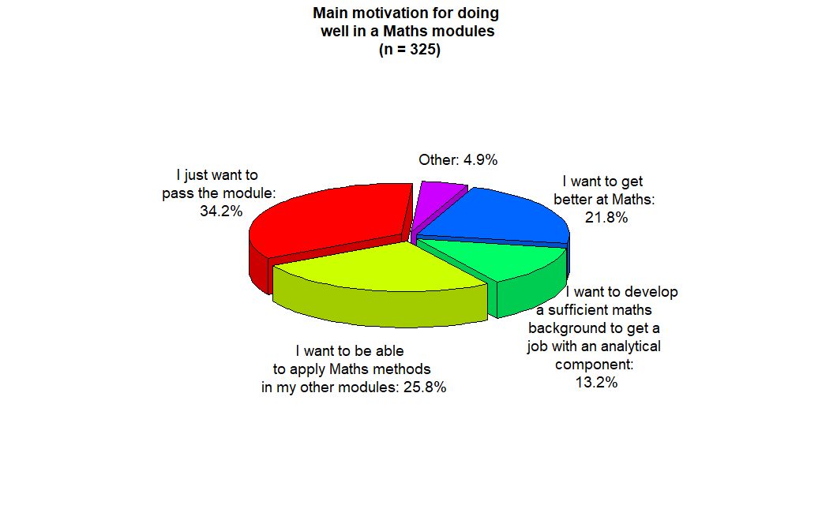
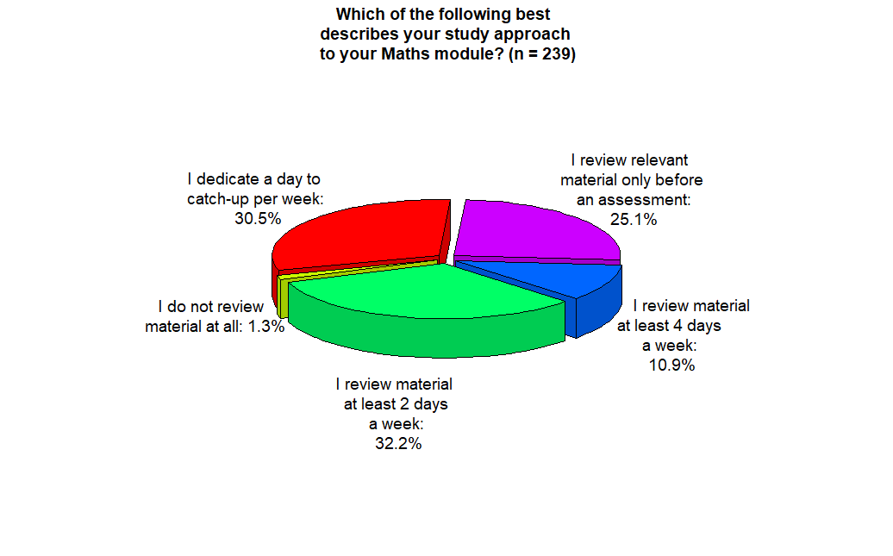
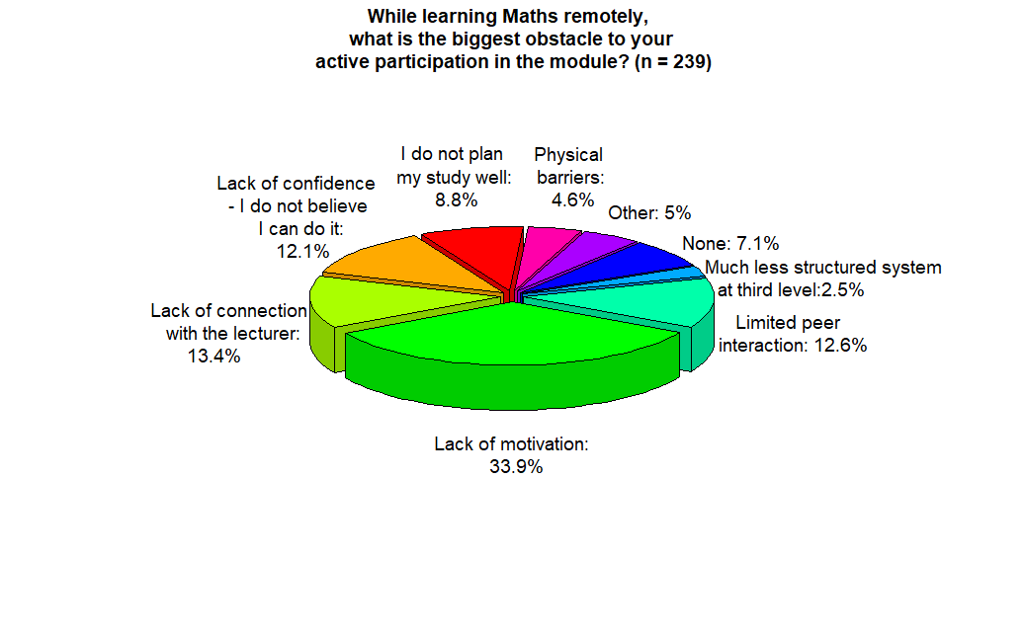

Slide 7
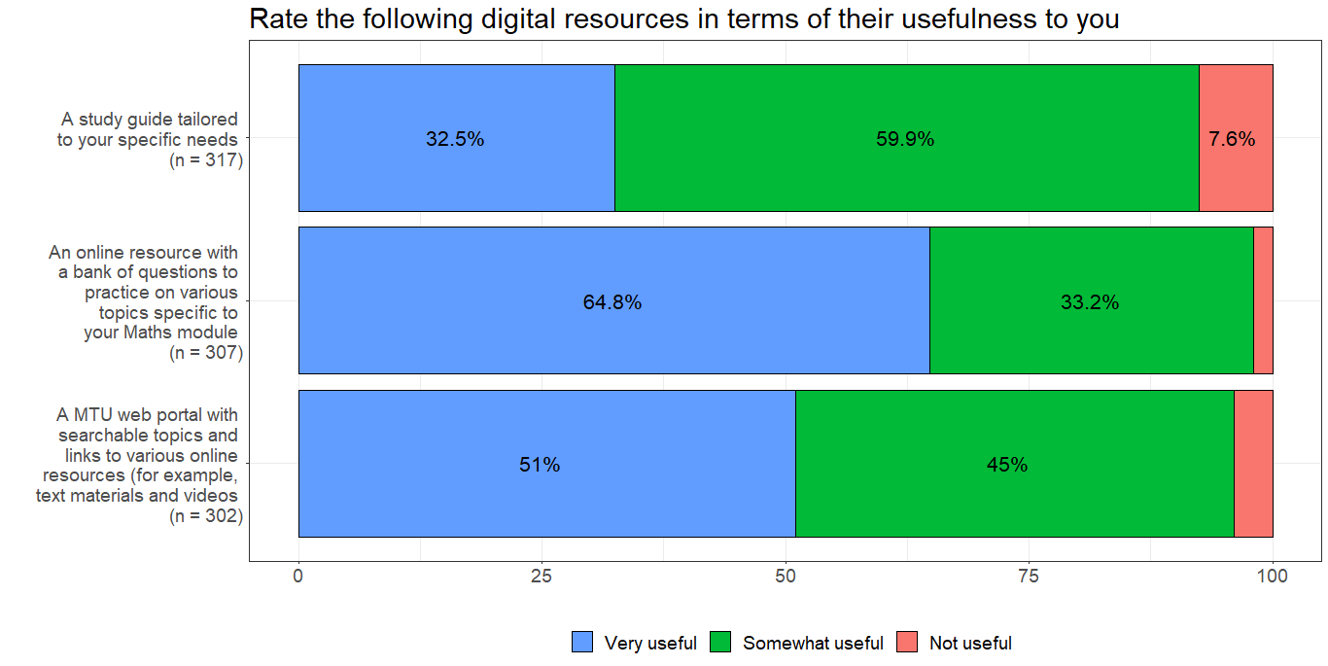

Slide 8
Digital Resources
Numbas Practice Questions
Video Solutions
H5P - Interactive Exam Questions
Student Feedback

Slide 9
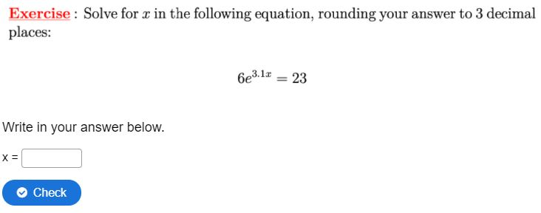
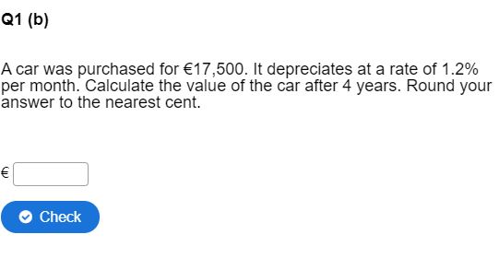
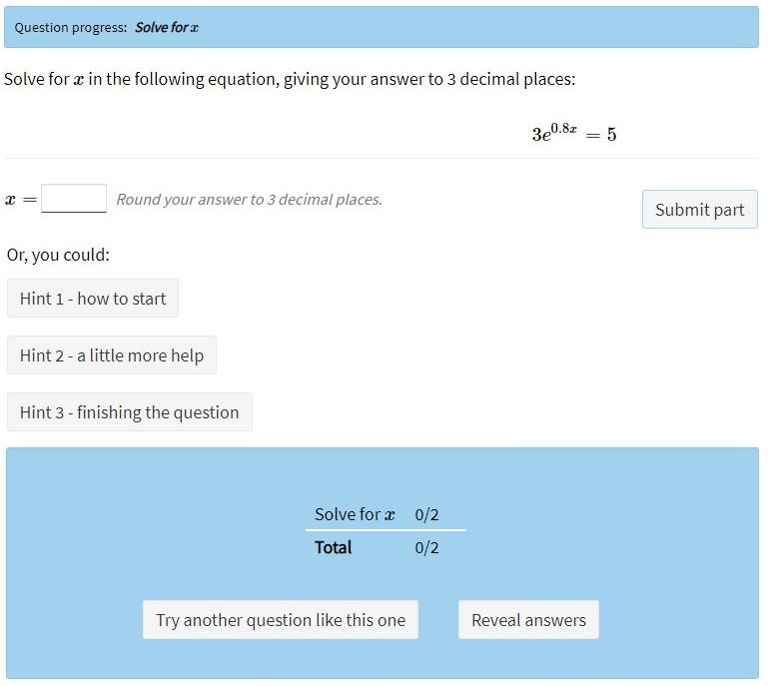
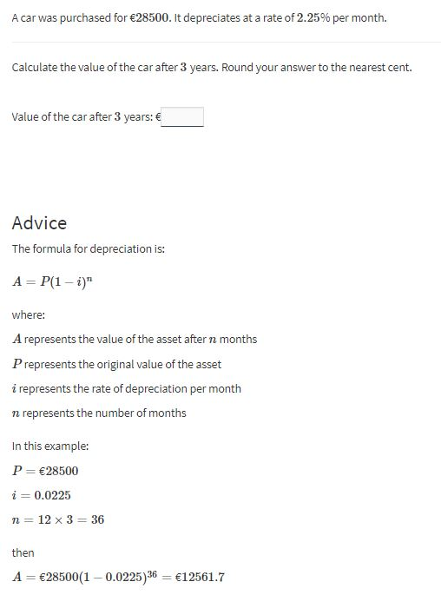
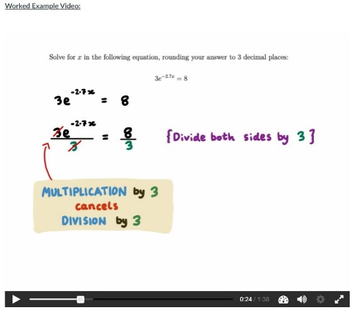
Novel digital learning resources
Work out your answer and enter it to check if it’s correct
Practise more questions of this type, get hints and instant feedback
H5P
Watch a video of worked solution
NUMBAS
Video

Slide 10
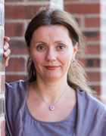
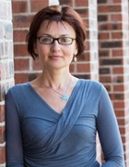
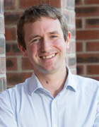
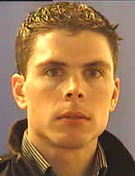
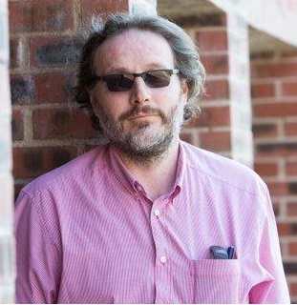
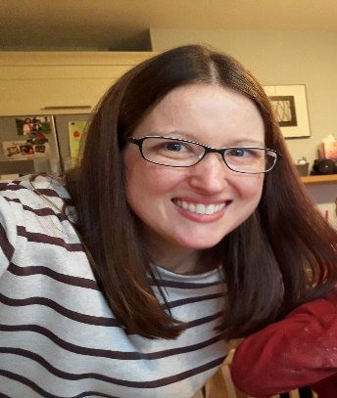
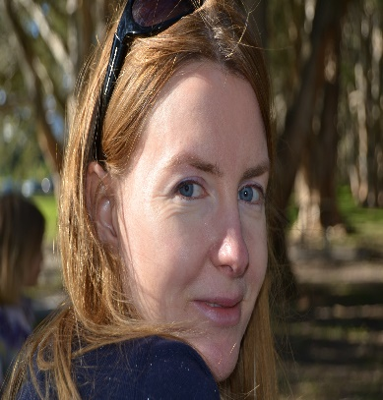
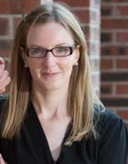
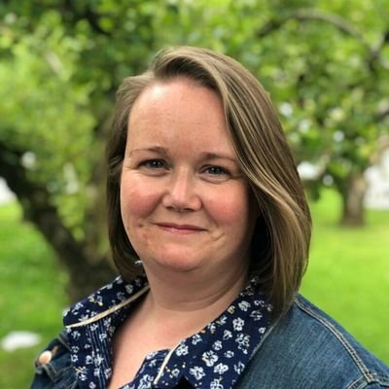
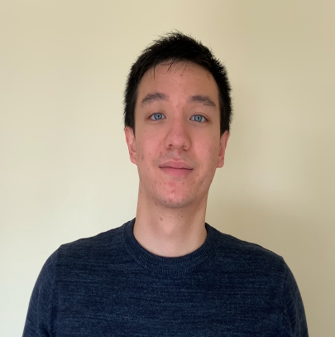
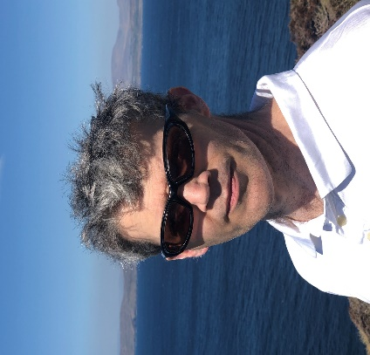
SPIRIT Maths Team
Dr Violeta Morari
Dr Maryna Lishchynska
Dr J.P. McCarthy
Dr Sean Lacey
Dr Declan O’Connor
Patricia Cogan
Dr Catherine Palmer
Dr Clodagh Carroll
Dr Julie Crowley
Deirdre Casey
Declan Manning
Dr Shane O’Rourke

Slide 11
SPIRIT Maths
www.spiritmaths.com
#spiritmaths
violeta.morari@cit.ie
clodagh.carroll@cit.ie
Supported by TLU and T&L National Forum

