Slide 1
The effectiveness of remediating mathematical Common Student Errors in e-Assessments
Indunil Sikurajapathi
Presented at the international conference on E-Assessment in Mathematical Sciences (EAMS 2021)
25-06-2021

Slide 2
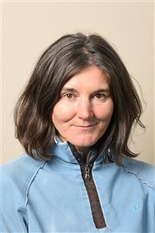
Project team
Indunil Sikurajapathi Lecturer in Mathematics PhD candidate | Dr Karen Henderson Associate Professor (Technology Enhanced Learning) | Dr Rhys Gwynllyw Associate Professor (Teaching and Learning)
Department of Engineering Design and Mathematics
Faculty of Environment and Technology
University of the West of England
Bristol, United Kingdom

Slide 3
Plan of talk
Background
The Common Student Errors (CSE) Project at UWE, Bristol
Stage One: Data (CSEs) Collection
Stage Two: CSE code Development
Stage Three: CSE code Trial Phase
Stage Four: Students’ Perceptions on CSE Feedback
Stage Five: Outcomes of CSE Project
Discussions and Conclusions

Slide 4
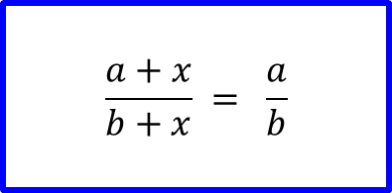
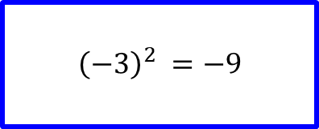
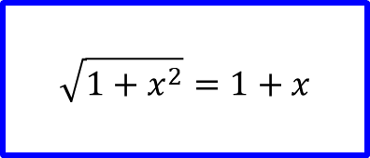
Background: Common Student Errors (CSEs)
Misconceptions; mistakes due to carelessness

Slide 5
Background: Dewis E-Assessment System
Developed at UWE Bristol
Algorithmic
Different question input types
Lossless data collection
Student friendly features

Slide 6
The Common Student Errors (CSEs) Project at UWE, Bristol
Research questions:
What CSEs do first year Engineering mathematics students make?
How to detect CSEs and improve Dewis feedback to address these CSEs?
Aim:
To introduce a method to detect CSEs and to provide tailored feedback in Engineering Mathematics e-Assessment questions on Dewis.

Slide 7
The Common Student Errors (CSEs) Project at UWE, Bristol...
Benefits:
Dewis emulates a human marker
Provides instant enhanced feedback highlighting possible CSEs made
Gives tailored guidance on how to improve students' topic knowledge
Teachers can identify areas in which more help is needed in student learning.
Students’ learning experience improves.
Beneficial to several disciplines and organisations.

Slide 8
CSE Project Stage One: Data (CSEs) Collection
Engineering Mathematics Module: Assessments and Practice tests
Regular weekly e-assessments (engagement & attainment)
Mid-module Revision test (practice tests)
Mid-module (January) e-examination (2 hours)
End of module (May) written examination

Slide 9
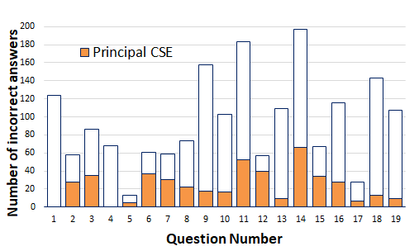
CSE Project Stage One: Data (CSEs) Collection...
2017/18 e-examination: 19 Dewis questions
Fixed parameters for the morning and afternoon sessions
Collected 298 students’ answer scripts (rough work)
Used Dewis Reporter to find Most Common Wrong Answers (CWAs)
Examined students’ rough work to find clues for Common Students Errors (CSEs) which led to the CWAs.
Collected 40 CSEs related to 17 Engineering Mathematics questions.

Slide 10
CSE Project Stage One: Data (CSEs) Collection...
40 CSEs found in the following mathematics topics:
Algebra
Unit-step function
Wave forms
Trigonometric functions
Differentiation
Implicit differentiation
Partial differentiation
Mean Value Theorem
Complex numbers
Geometric series
Maclaurin Expansion
Centre of Mass
Integration by parts
Volume of revolution
For more details on outcomes of the first stage of the CSE Project can be found at:
Sikurajapathi, I., Henderson, K., and Gwynllyw, R., 2020. Using E-Assessment to Address Mathematical Misconceptions in Engineering Students. International Journal of Information and Education Technology. 10(5), pp.356–361.

Slide 11
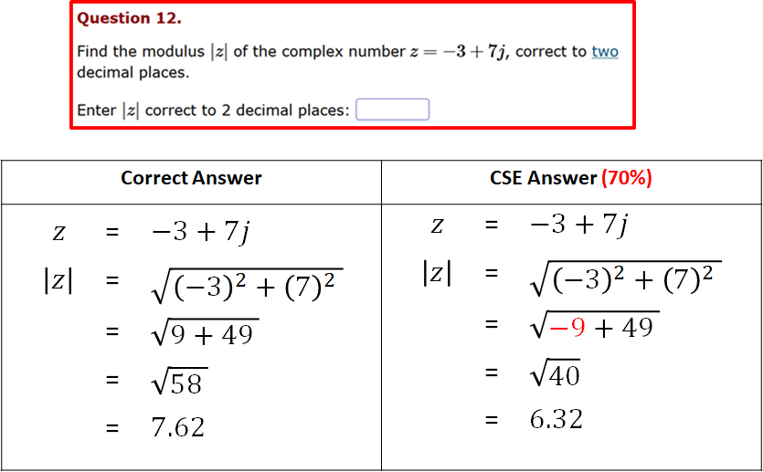
CSE Project Stage One: Data (CSEs) Collection …
CSE Example 1

Slide 12
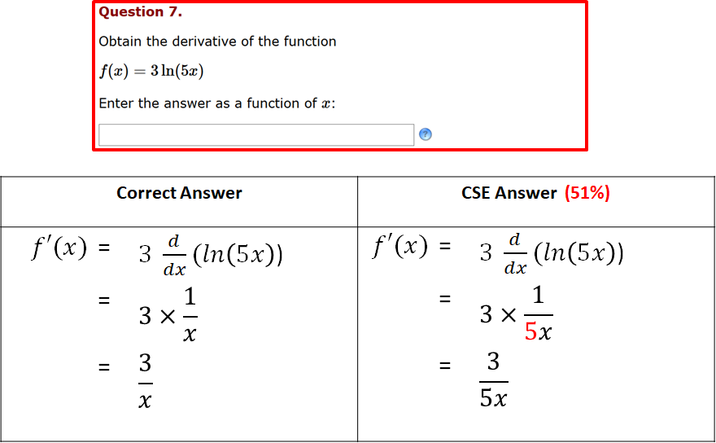
CSE Project Stage One: Data (CSEs) Collection …
CSE Example 2

Slide 13
CSE Project Stage Two: CSE code Development
Introduced additional Performance Indicators (PIs) into each original question code to capture CSEs when they are triggered.
Created detailed feedback based on students’ answers:
Highlighted what could have gone wrong
(possible CSE) in the Report section
Used different colours and boxes to emphasis
the important facts
Created clear detailed step by step FEEDBACK
Provided Additional Notes where necessary

Slide 14
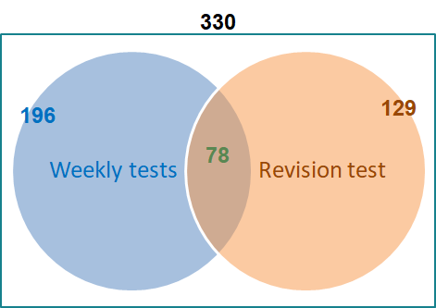
CSE Project Stage Three: CSE code Trial Phase
Improved questions used in 2019/20 (total no. of students: 330)
Weekly tests:
15 questions which capture 29 CSEs altogether
196 distinct students received enhanced feedback
Revision test:
9 questions which capture 21 CSEs altogether
129 distinct students received enhanced feedback
78 distinct students received enhanced feedback for questions in both weekly or revision tests
247 distinct students received enhanced feedback for questions either in weekly or revision tests

Slide 15
CSE Project Stage Four- Students’ Perceptions on CSE Feedback
An online questionnaire
Aim: To gather students’ views on the enhanced feedback they received
How and to what extent does the current enhanced feedback help students to change their conceptual understanding and facilitate their understanding of the subject?
What are their views on the user-friendly features of the enhanced feedback?
Outcomes of the Likert-scale questions
Statement | Agreement Percentage
The enhanced feedback improved my mathematical understanding | 88%
The enhanced feedback makes me feel confident/comfortable with Engineering Mathematics | 73%
The information in the enhanced feedback is relevant to the question asked | 95%
I am satisfied with the overall structure of the enhanced feedback | 87%
For more details on outcomes of open-ended questions and the whole questionnaire can be found at:
Sikurajapathi, I., Henderson, K., and Gwynllyw, R., (under review). Students’ Perceptions of Enhanced e-Assessment Feedback Addressing Common Student Errors in Mathematics. MSOR Connections

Slide 16
CSE Project Stage Four- Students’ Perceptions on CSE Feedback...
A few responses to Open-ended questions:
What do you like about the enhanced feedback you received?
“Very useful and well structured.”
“The enhanced feedback got right to the reason the answer was wrong.”
“The fact that it tells you what you've done based on your final input is clever.”
“I think it is a great model of reinforcing problems of understanding.”
“It was certainly useful to receive enhanced feedback alongside the standard feedback.”

Slide 17
CSE Project Stage Four- Students’ Perceptions on CSE Feedback...
What do you dislike about the enhanced feedback you received?
“Nothing.”
“Some answers can be quite brief so more in depth answers would be great.”
“I wish the enhanced feedback was more detailed.”
Do you have any suggestions for improvement?
“Include all steps, even if they seem unimportant.”
“I think it is as good as it can be. Thank you!”
“Not all questions has enhanced feedback.”
“Videos of a maths teacher doing each question and talking through each step.”

Slide 18
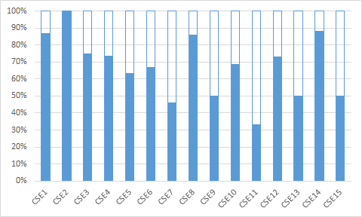
CSE Project Stage Five : Outcomes of CSE Project
8 Improved questions included in the end of semester (controlled conditioned) exam 2019/20
Tested for 17 CSEs, only 15 CSEs triggered
Success rate %
CSE ID | No. of students who received CSE EFB before the exam & answered correctly in the exam (A) | No. of students who received CSE EFB before the exam (B) | Success rate (A/B%)
CSE1 | 86 | 99 | 87%
CSE2 | 11 | 11 | 100%
CSE3 | 3 | 4 | 75%
CSE4 | 44 | 60 | 73%
CSE5 | 12 | 19 | 63%
CSE6 | 4 | 6 | 67%
CSE7 | 6 | 13 | 46%
CSE8 | 6 | 7 | 86%
CSE9 | 14 | 28 | 50%
CSE10 | 11 | 16 | 69%
CSE11 | 1 | 3 | 33%
CSE12 | 19 | 26 | 73%
CSE13 | 2 | 4 | 50%
CSE14 | 15 | 17 | 88%
CSE15 | 6 | 12 | 50%

Slide 19
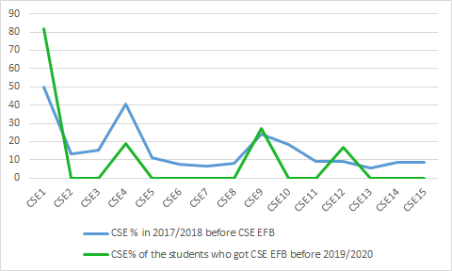
CSE Project Stage Five: Outcomes of CSE Project...
Comparing CSE occurrence before and after Dewis has the CSE enhanced feedback feature
 | 2017/2018 before CSE EFB |  |  | 2019/2020 after CSE EFB
 | No. of times CSE triggered (C) | No. of incorrect answers (D) | CSE % (C/D %) | No. of times CSE triggered by students who had previously received EFB (E) | No. of incorrect answers submitted by students who had previously received EFB (F) | CSE % (E/F %)
CSE1 | 28 | 56 | 50% | 9 | 11 | 82%
CSE2 | 6 | 45 | 13% | 0 | 0 | 0%
CSE3 | 4 | 26 | 15% | 0 | 1 | 0%
CSE4 | 35 | 86 | 41% | 3 | 16 | 19%
CSE5 | 18 | 158 | 11% | 0 | 7 | 0%
CSE6 | 12 | 158 | 8% | 0 | 2 | 0%
CSE7 | 10 | 158 | 6% | 0 | 7 | 0%
CSE8 | 9 | 109 | 8% | 0 | 1 | 0%
CSE9 | 28 | 116 | 24% | 3 | 11 | 27%
CSE10 | 11 | 59 | 19% | 0 | 2 | 0%
CSE11 | 13 | 143 | 9% | 0 | 2 | 0%
CSE12 | 13 | 143 | 9% | 1 | 6 | 17%
CSE13 | 8 | 143 | 6% | 0 | 1 | 0%
CSE14 | 9 | 107 | 8% | 0 | 2 | 0%
CSE15 | 9 | 107 | 8% | 0 | 6 | 0%

Slide 20
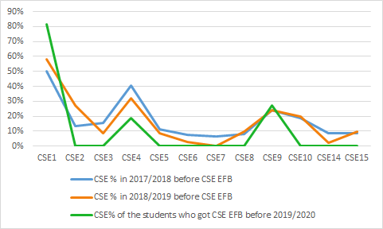
CSE Project Stage Five: Outcomes of CSE Project
Re-marked 2018/2019 exam with new Enhanced Feedback code
Comparing 6 questions ( 12 CSEs) given in 2017/2018, 2018/2019, 2019/2020
 | 2017/2018 before CSE EFB |  |  | 2018/2019 before CSE EFB |  |  | 2019/2020 after CSE EFB
 | No. of times CSE Triggered (C) | No. of incorrect Answers (D) | CSE % (C/D %) | No. of times CSE Triggered (G) | No. of incorrect Answers (H) | CSE % (G/H %) | No. of times CSE triggered by students Who had previously received EFB (E) | No. Of incorrect answers submitted by students who had previously received EFB (F) | CSE % (E/F%)
CSE1 | 28 | 56 | 50% | 33 | 57 | 58% | 9 | 11 | 82%
CSE2 | 6 | 45 | 13% | 14 | 51 | 27% | 0 | 0 | 0%
CSE3 | 4 | 26 | 15% | 2 | 24 | 8% | 0 | 1 | 0%
CSE4 | 35 | 86 | 41% | 32 | 100 | 32% | 3 | 16 | 19%
CSE5 | 18 | 158 | 11% | 15 | 180 | 8% | 0 | 7 | 0%
CSE6 | 12 | 158 | 8% | 5 | 180 | 3% | 0 | 2 | 0%
CSE7 | 10 | 158 | 6% | 0 | 180 | 0% | 0 | 7 | 0%
CSE8 | 9 | 109 | 8% | 9 | 95 | 9% | 0 | 1 | 0%
CSE9 | 28 | 116 | 24% | 29 | 122 | 24% | 3 | 11 | 27%
CSE10 | 11 | 59 | 19% | 16 | 80 | 20% | 0 | 2 | 0%
CSE14 | 9 | 107 | 8% | 3 | 135 | 2% | 0 | 2 | 0%
CSE15 | 9 | 107 | 8% | 13 | 135 | 10% | 0 | 6 | 0%

Slide 21
Discussions and conclusions
Dewis has a new feature in detecting CSEs and emulates a human marker:
Provides instant enhanced feedback highlighting possible CSEs made
Gives tailored guidance on how to improve their knowledge related to the topic
We can now easily address CSEs in a large cohort
Long-term benefit of this feature outweigh the time to identify CSEs and write enhanced feedback
Can be utilised in other cohorts
Teachers can identify areas in which more help is needed in student learning.
Students’ learning experience improves.
Further development of Dewis will be beneficial to several disciplines and organisations.
Similar methods can be used to develop other e-Assessment Systems.

Slide 22
Thank you !

