Slide 1
www.ans.app | hello@ans.app

Slide 2
Today
Story of Ans
How does Ans work?
3 STEM use cases
STEM question types
Variables
Handwritten and hybrid exams
Live Product Demonstration
Q&A
Notes:
Free up educators time on assessments by 50% using one platform for all assessment steps.
Remove administration hassle for manual handwritten assessments by reviewing them online.
No matter where you are, you can delegate questions to Teaching Assistants, collaborate, discuss and grade as a team!
Create a unique exam for each student by making use of randomization and variables.

Slide 5
The story of Ans
2023
25+ Ans specialists, 1.000+ institutions, 75.000+ teachers
2022
Moved to a new office to support our team’s growth
2020
The pandemic accelerated the demand for Ans
2018
More schools followed and choose Ans as their assessment platform
2015
First teachers started with pilot of Ans
2014
Founded by TU Delft students

Slide 6
The satisfying workflow
[2] Questions
Create questions manually or add them from the question bank
[1] Assignment
Choose your assignment type, written or digital
[3] Taking
Choose the utilities and settings for the assignment
[5] Insights
Receive valuable insights about assignments and change contributions of questions
[4] Grading
Grade digital or written assignments together, either per student or per question

Slide 7
Supported Integrations
Learning Management Systems
Proctoring
Lockdown browser software
Print & Scan
Plagiarism
Text-to-Speech

Slide 8
Some of our customers
"I would say we have used it extensively now
and wouldn't go back to the old way of doing things.”
James Stanforth - Director of Digital Education (source)

Slide 9
3 STEM Case studies
STEM question types
Coding
Worksheet
Mathematical
Drawing
Webcam
Question generation
Variables
Hybrid
Handwritten
Digital

Slide 10
Live Product Demonstration
By Madalina-Nicoleta Bulumac &
Christopher Smith Idehenre

Slide 11
Q & A

Slide 12
Contact us or schedule an appointment via the website. You can also register online for your own free trial environment.
Get in touch with our Ans specialists via:
hello@ans.app
www.ans.app

Slide 13
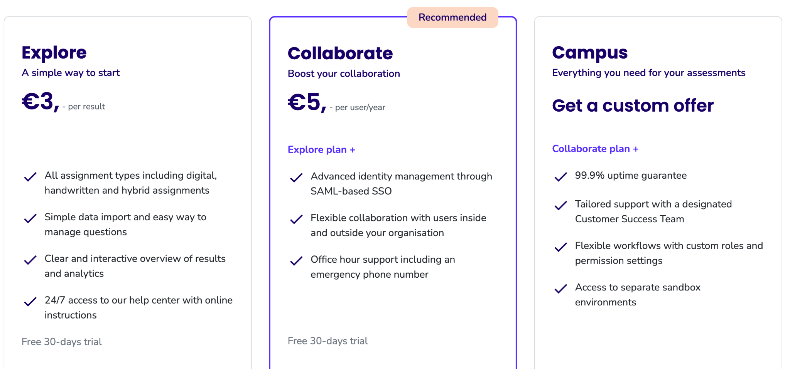
Pricing Plans

